Slide 1





Best Practices for District-Wide Wireless Display Deployment
Theodore Ragavas
Supervisor of Technology – Monmouth Regional High School
MIE Expert – MIE Master Trainer – ScreenBeam Expert

Slide 2
Choose your path!
Whats in the box?
Screenbeam CMS – Server settings and configurations (Server Side)
ScreenBeam Setup without CMS Server
Connecting to ScreenBeams without Classroom Commander
Contact information – Theo
ScreenBeam Info.
Monmouth Regional Story – How we got started
ScreenBeam for MAC Computers
Microsoft Whiteboard App/ScreenBeam
Client View/Settings
  Teacher
  Student

Slide 3
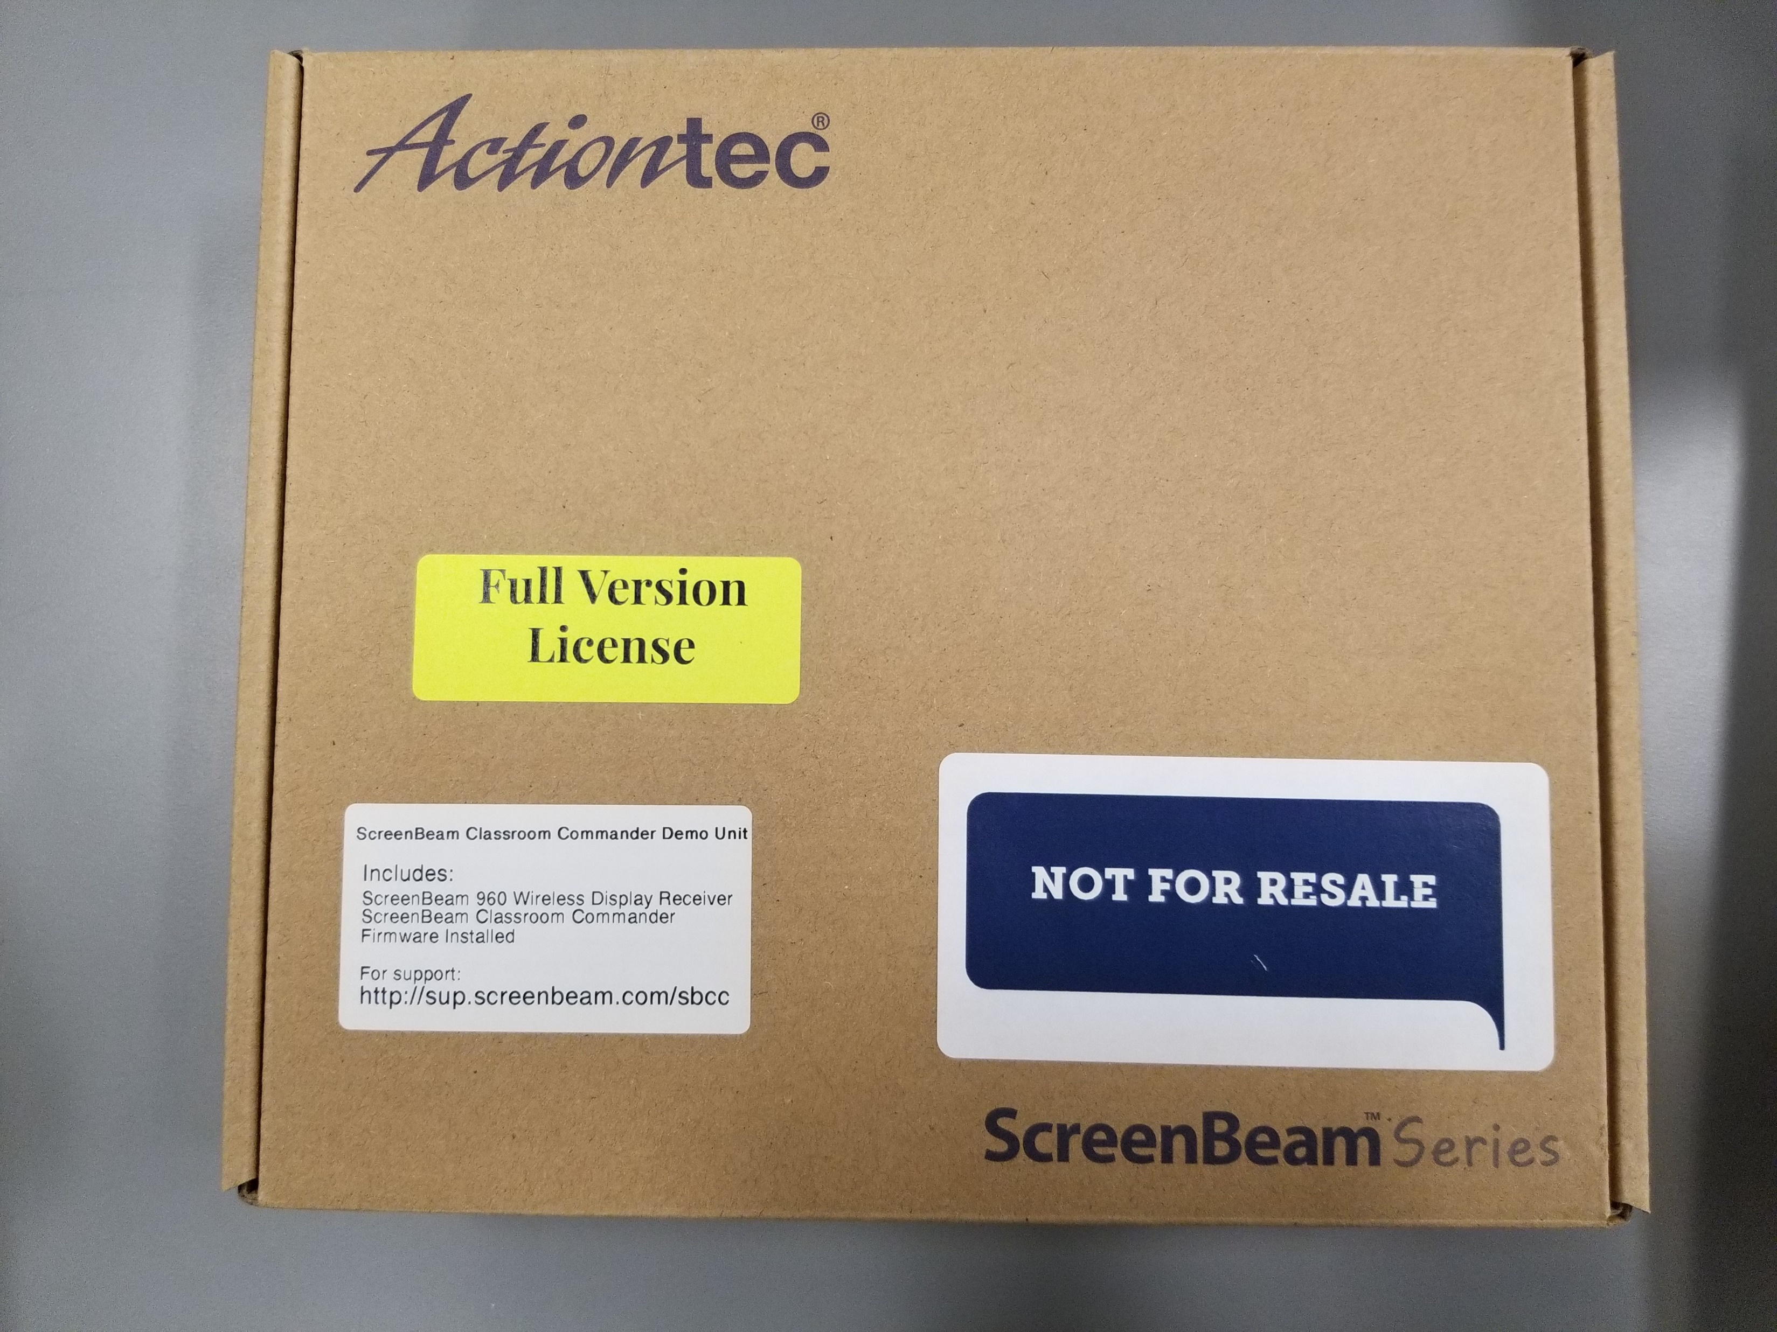
Actiontec ScreenBeam 960

Slide 4
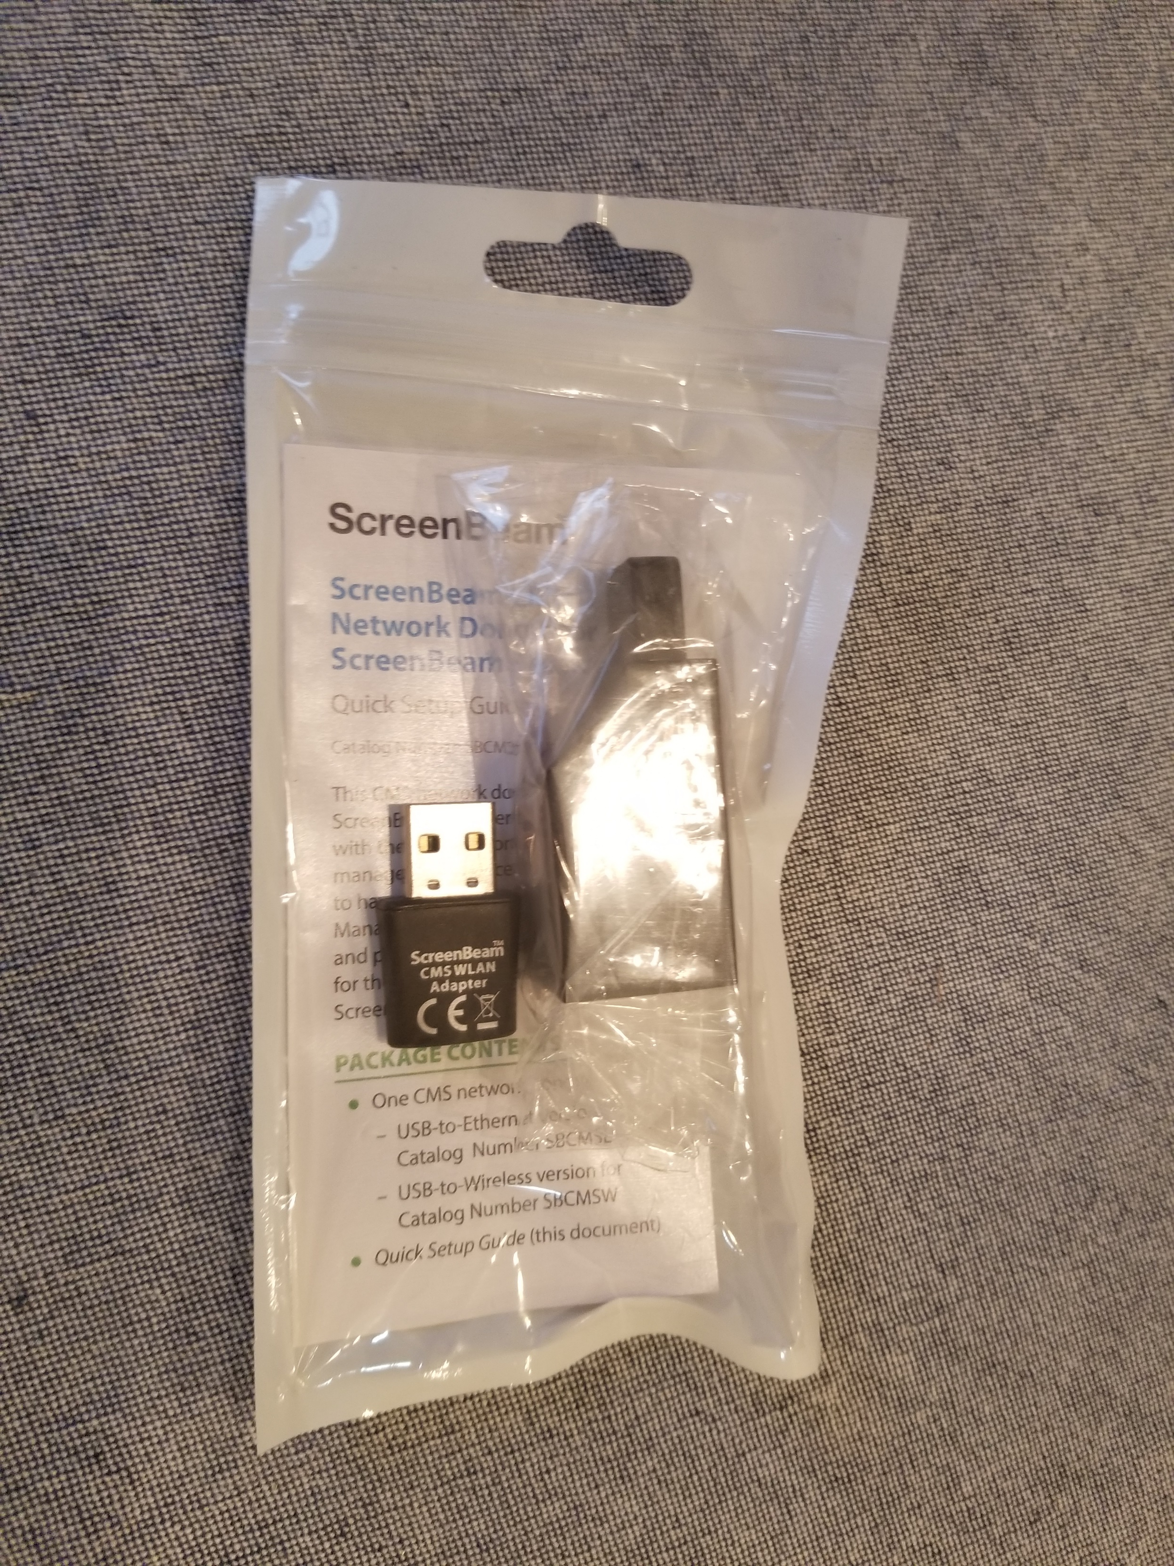
USB Adapter with CMS wireless adapter

Slide 5

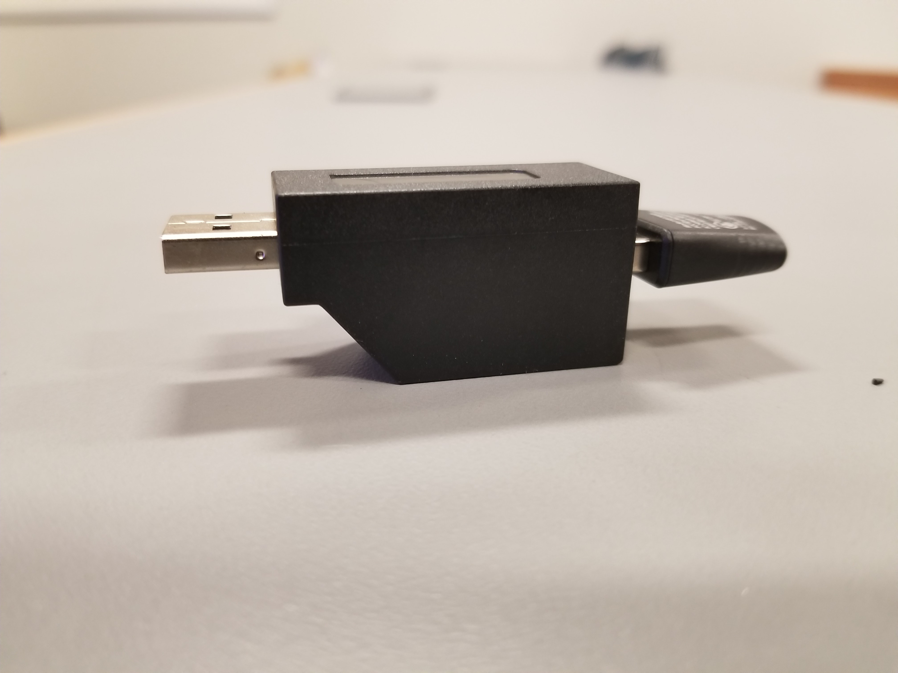
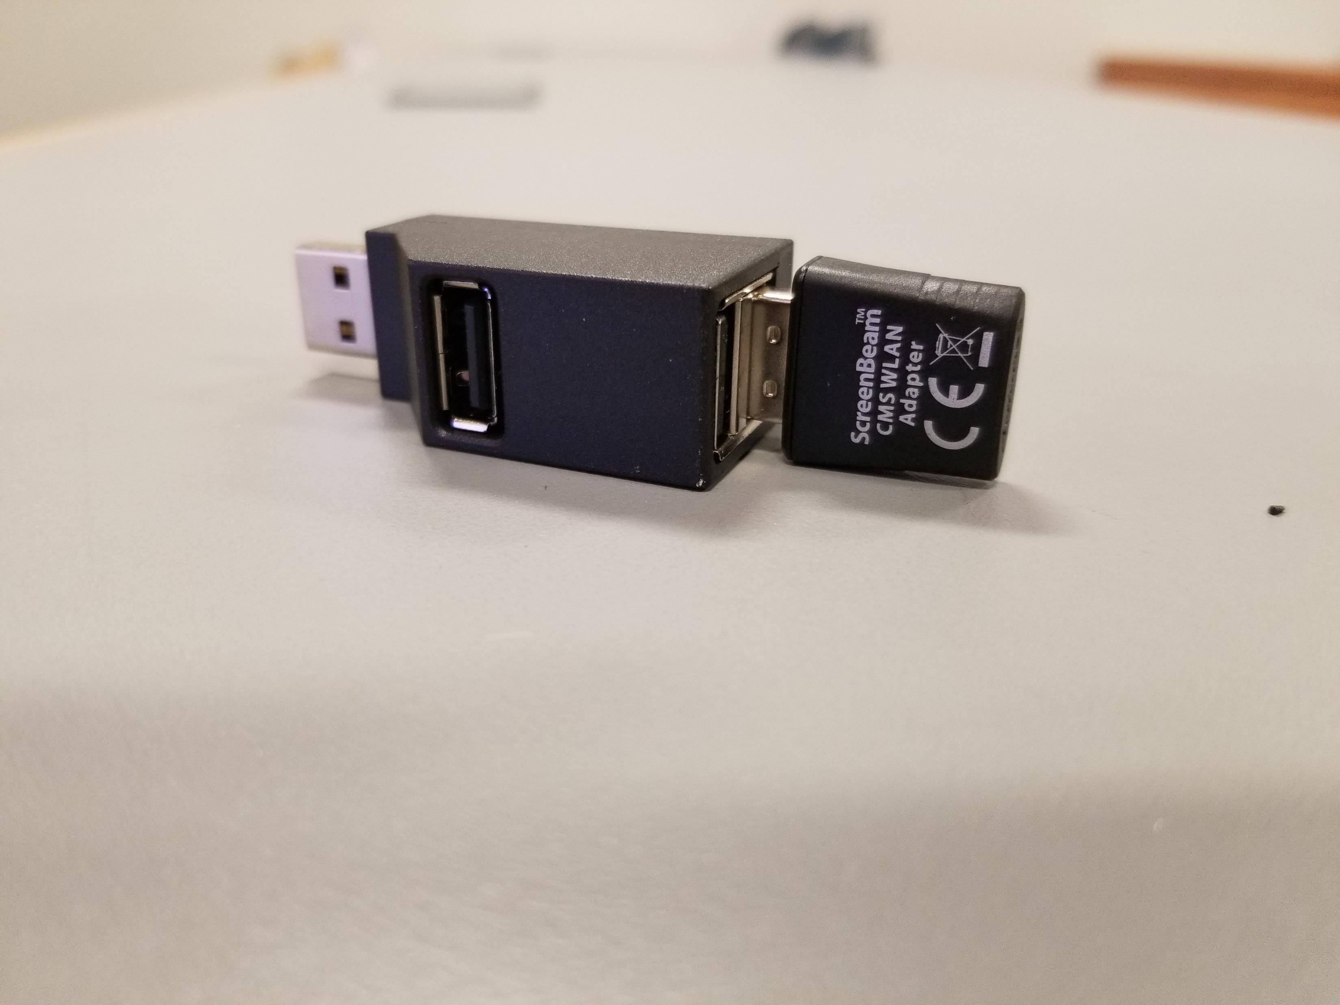
3 port USB Hub
3 USB ports available
1 Used for USB CMS Wireless adapter
2 used for USB cable for Interactive Panel/Projector

Slide 6
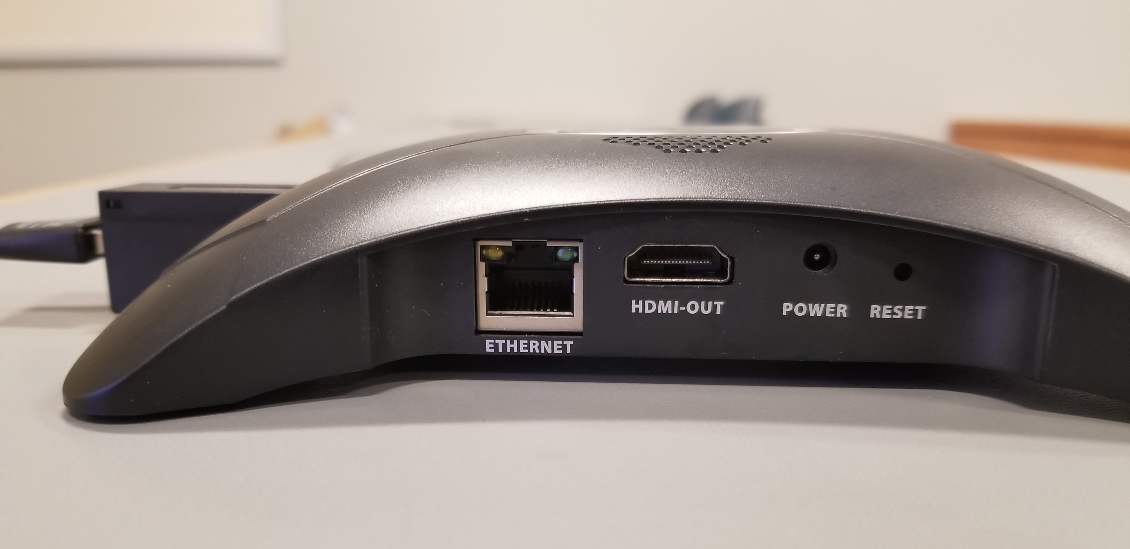
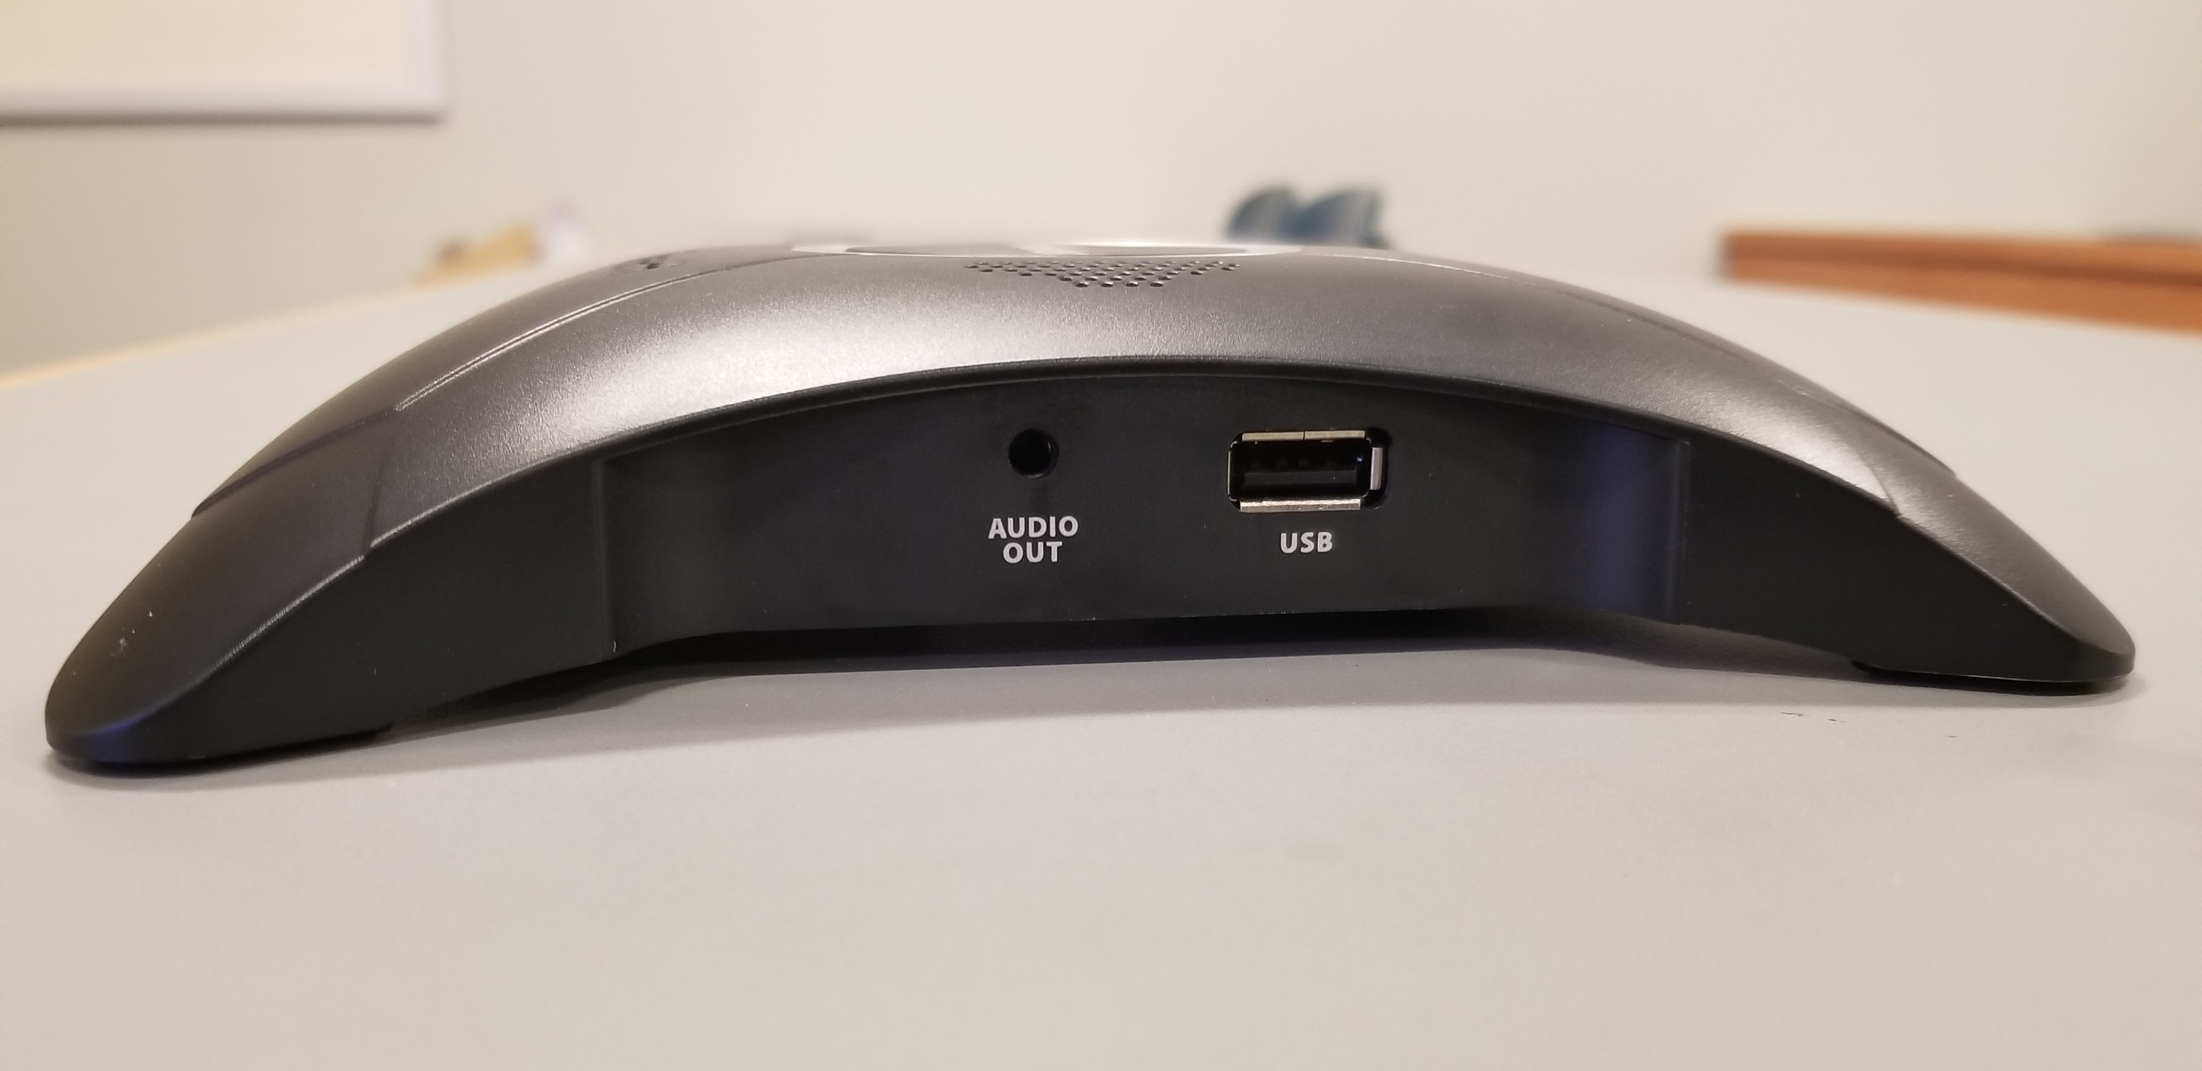
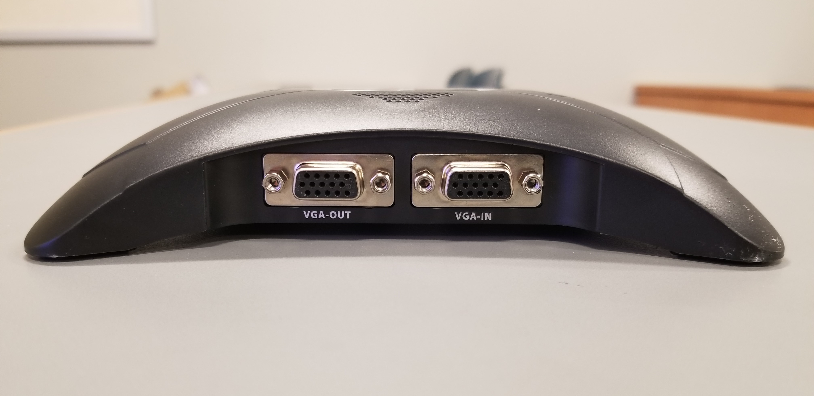
960 Reciever
Side 1: Ethernet for CMS optional if not using wireless adapter, HDMI out, Power Adapter, Hard reset button
Side 2: Audio out & USB Port
Side 3: VGA in & VGA Out

Slide 7
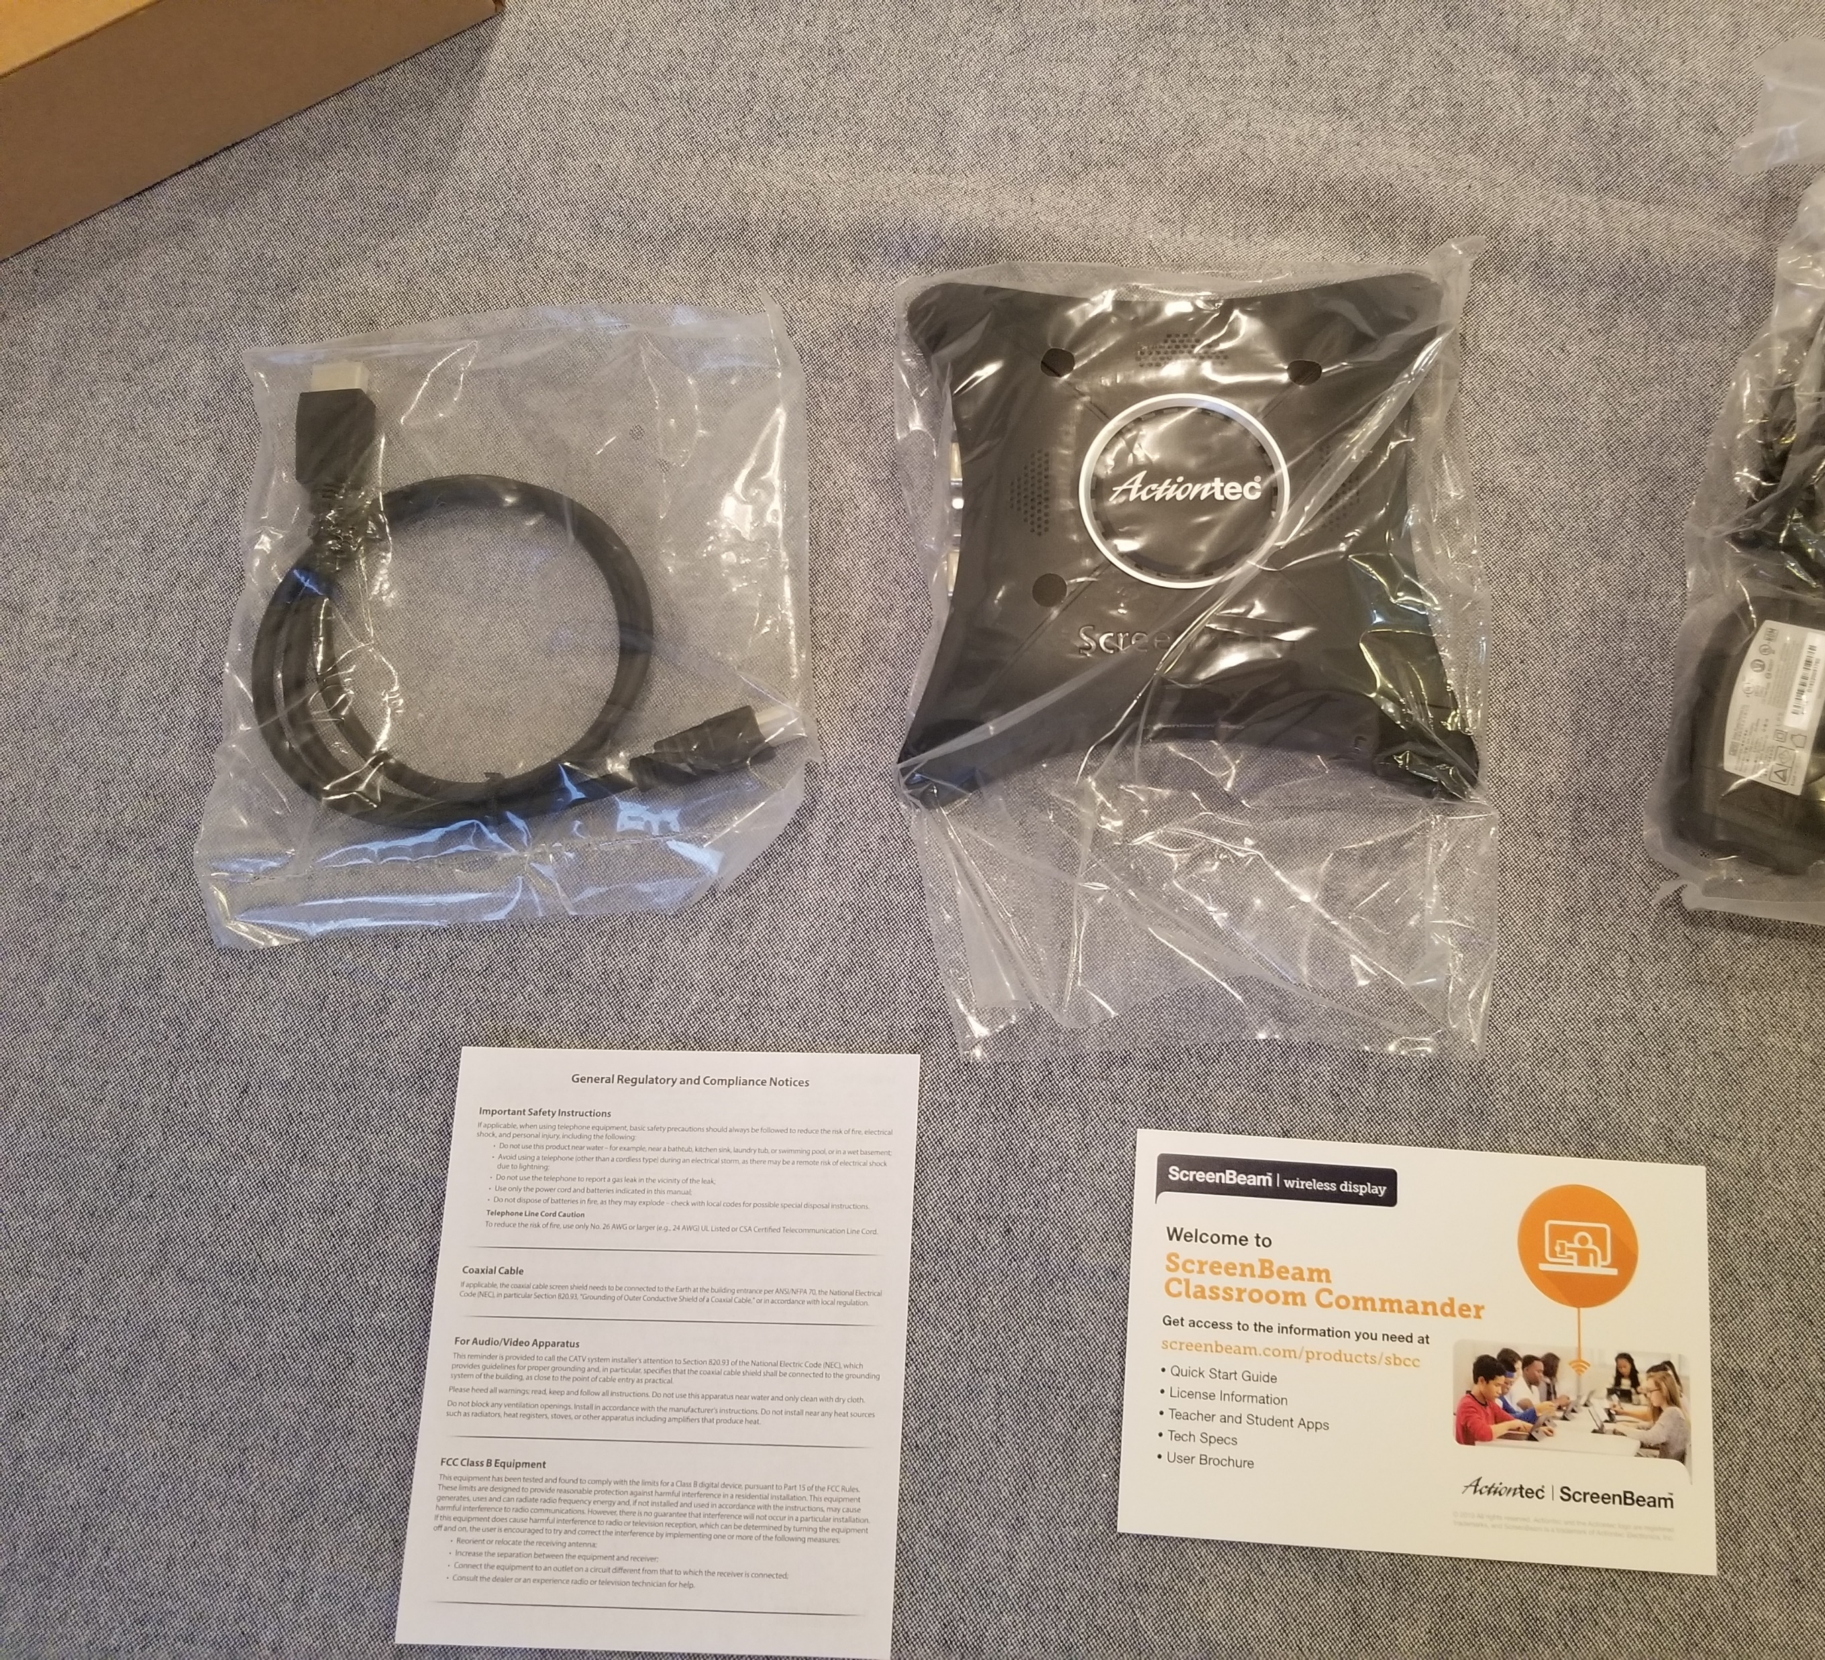
Contents in the box
Actiontec 960 ScreenBeam receiver
HDMI Cable approx. 4ft
Power Cable
Data sheet
Help Card
***Not included ***
  USB Cable
  Ethernet cable
  VGA Cables

Slide 8
ScreenBeam Configuration without CMS Server(s)

Slide 9
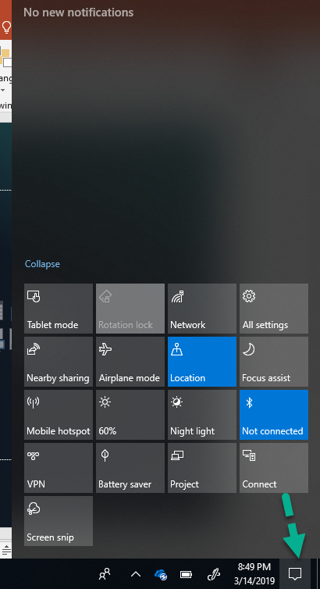
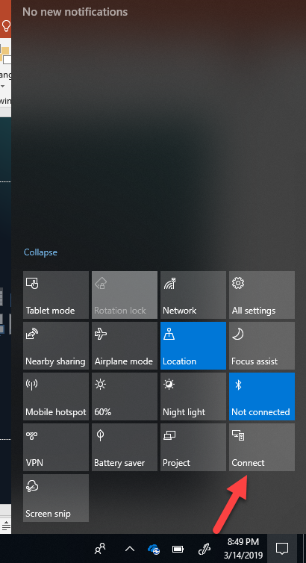
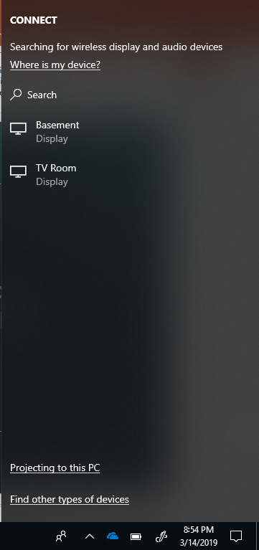
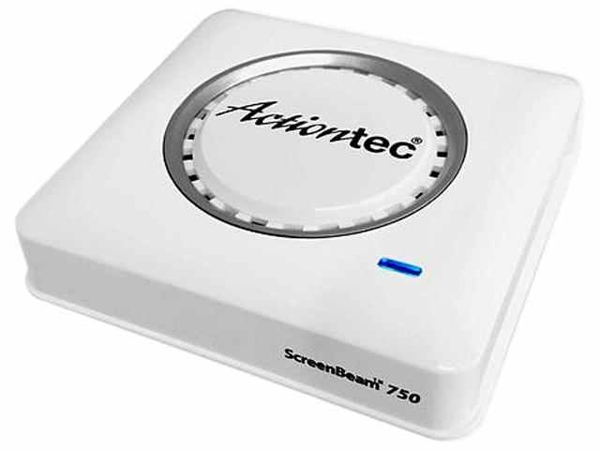
Actiontec Wireless Display Setup

Slide 10
Connecting to ScreenBeam GUI
Once you connect to the ScreenBeam

Slide 11

ScreenBeam CMS
(Central Management System)

Slide 12

ScreenBeam CMS
Information can be found: https://www.screenbeam.com/products/screenbeam-cms/
Download CMS, Firmware, Guides & FAQ: https://screenbeam.zendesk.com/hc/en-us/categories/360001017912

Slide 13
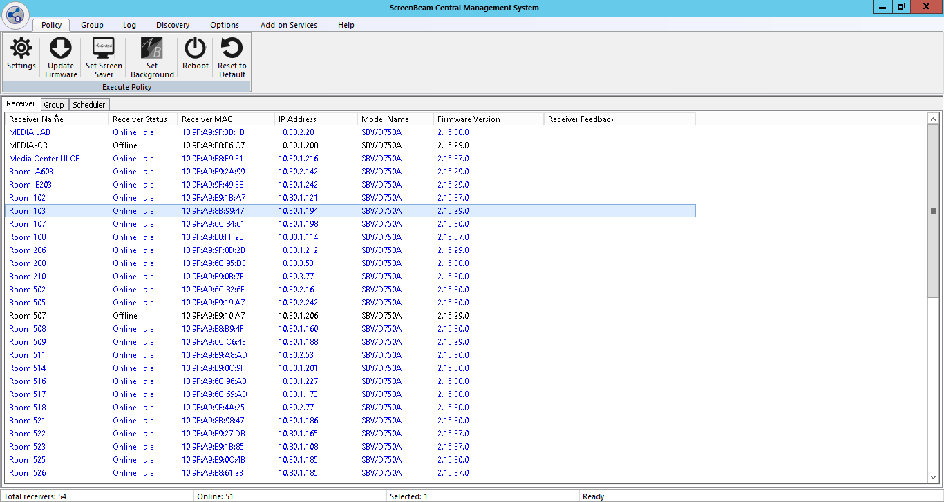

Slide 14
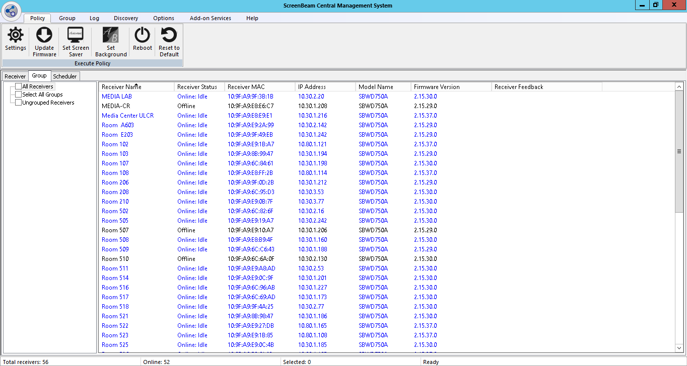

Slide 15
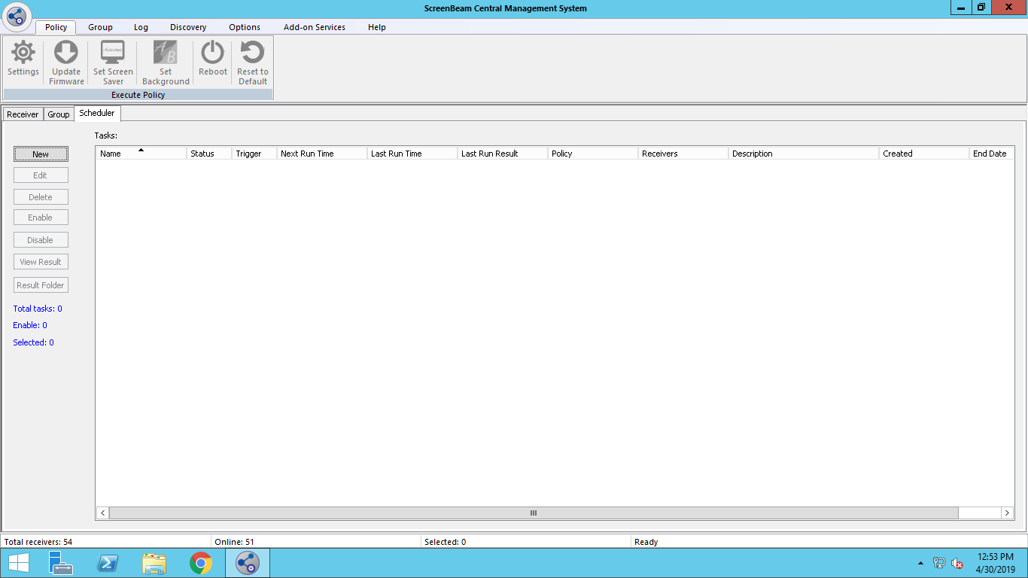

Slide 16
CMS – Policy Settings

Slide 17
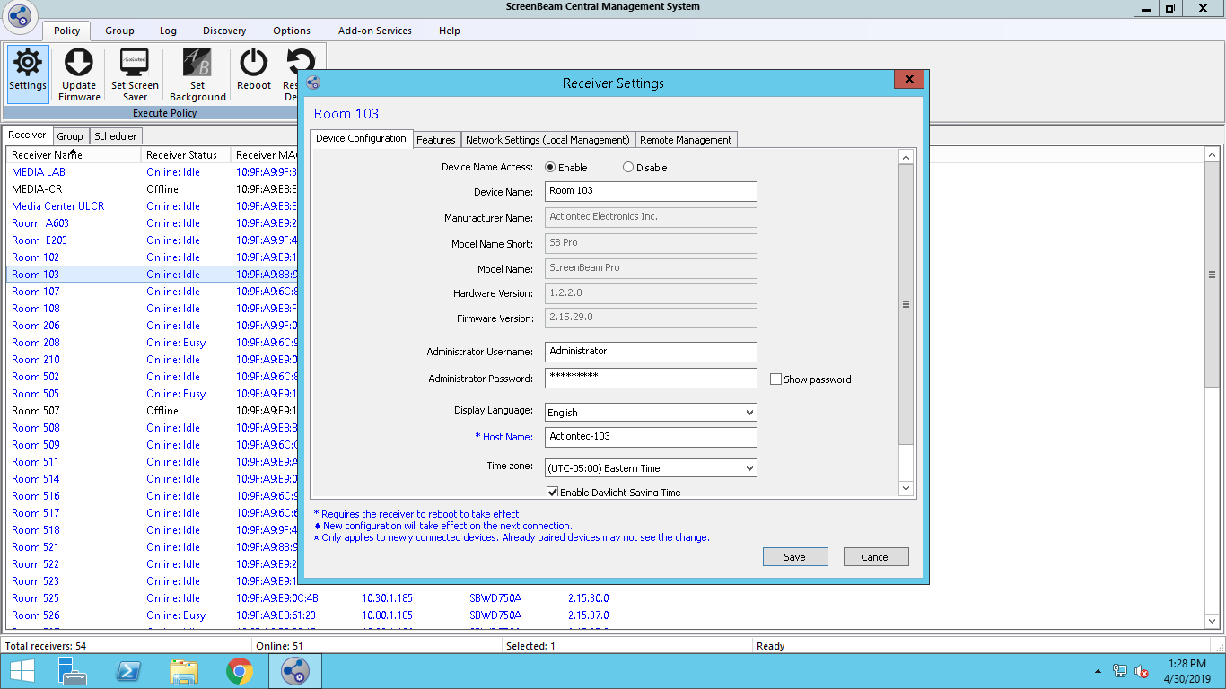

Slide 18
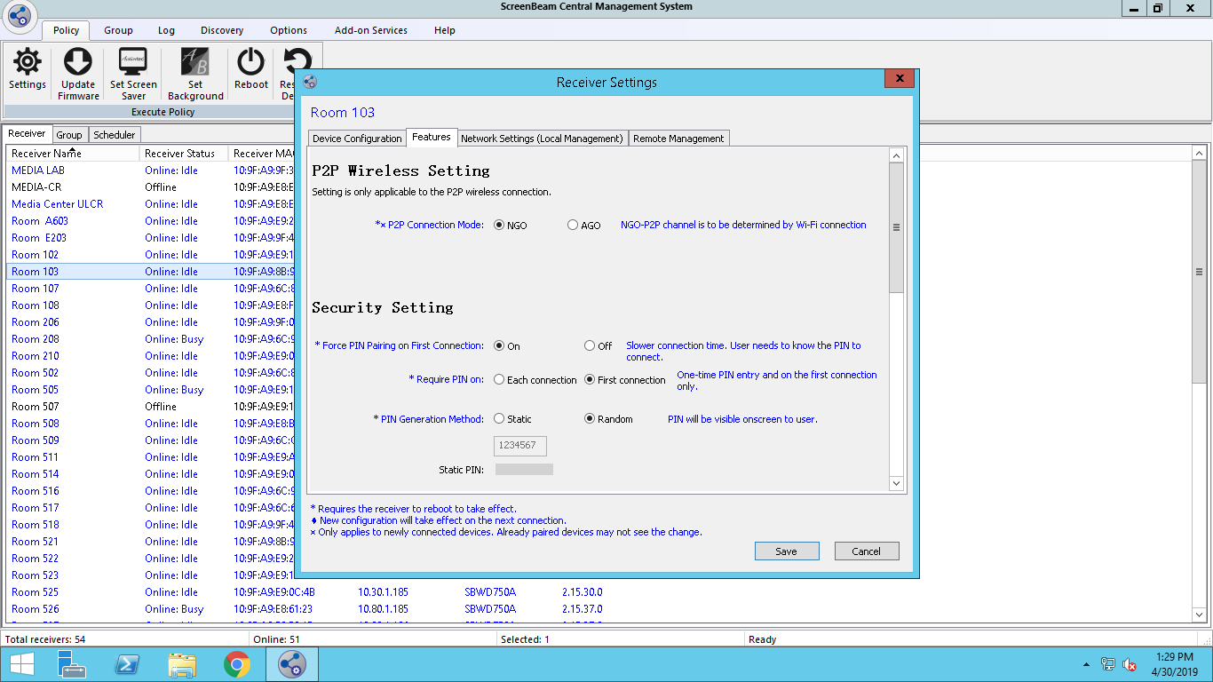

Slide 19
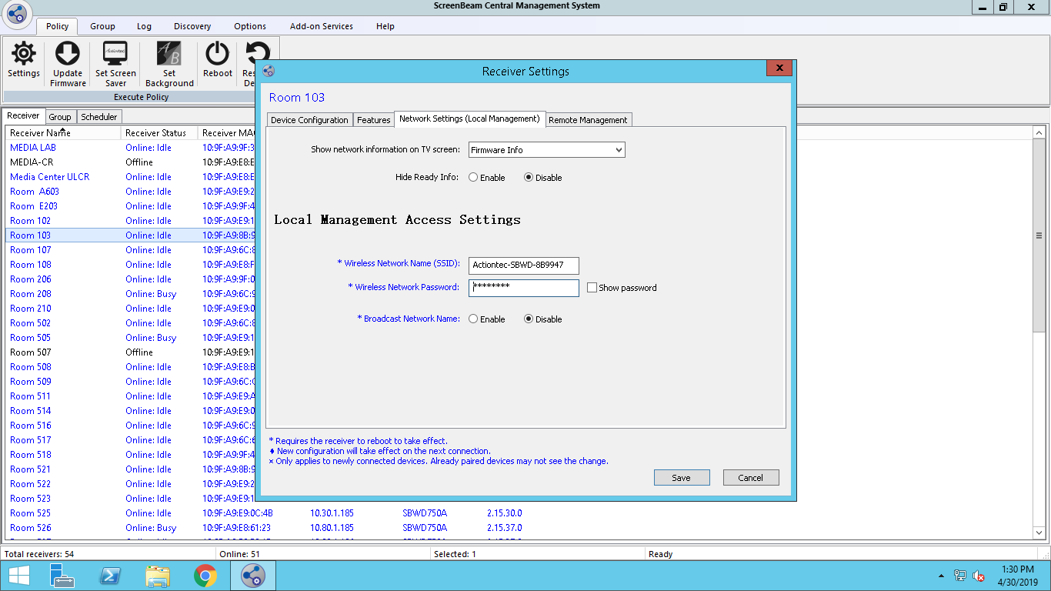

Slide 20
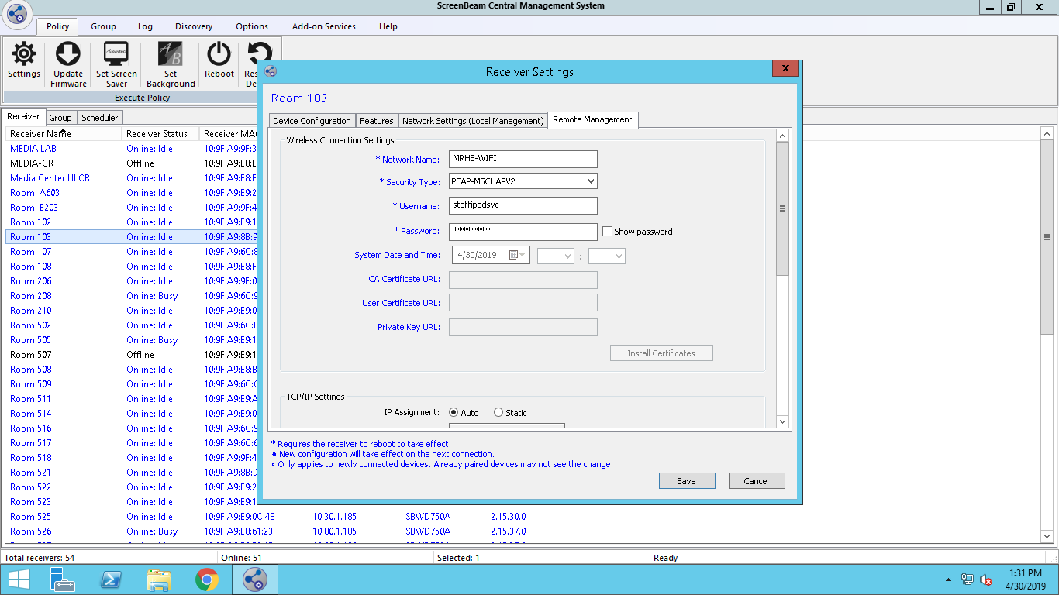

Slide 21
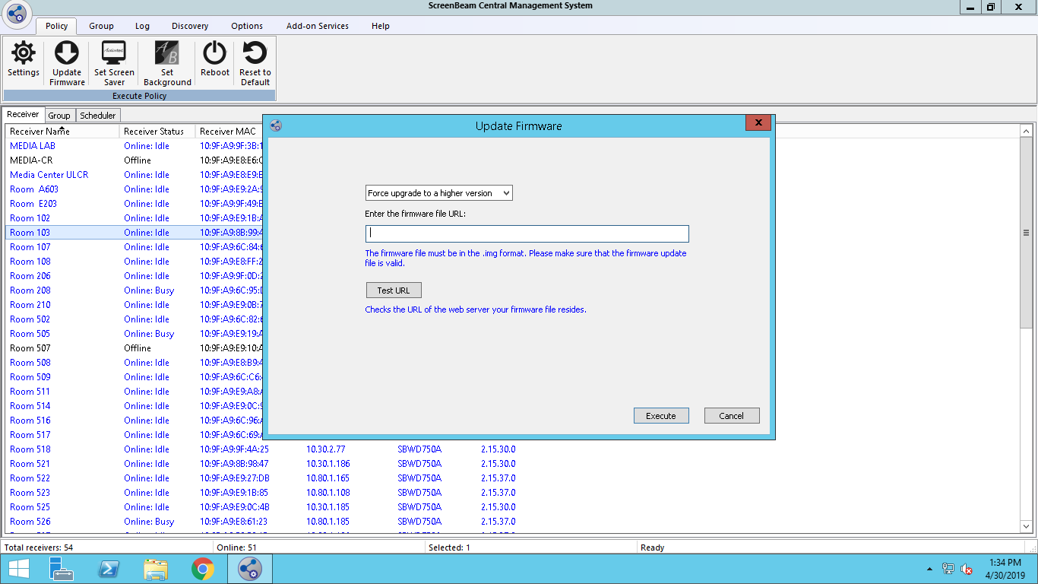

Slide 22
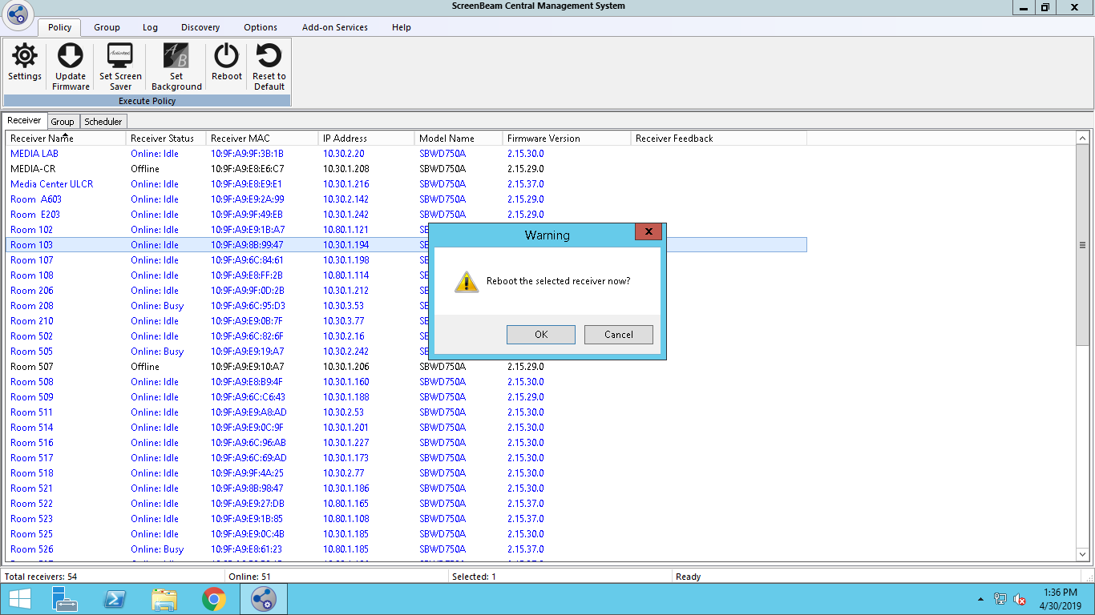

Slide 23
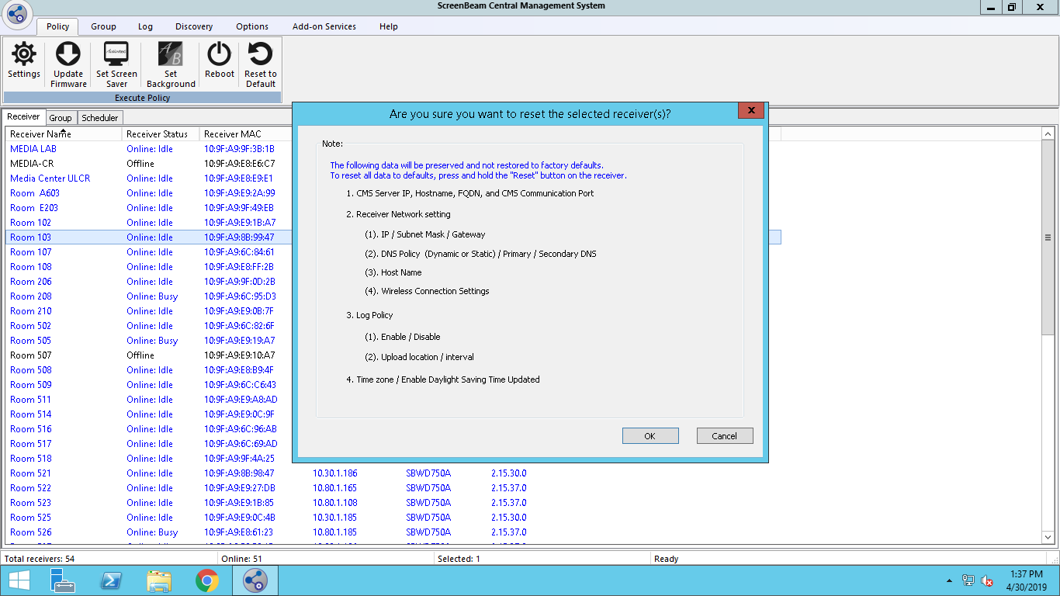

Slide 24
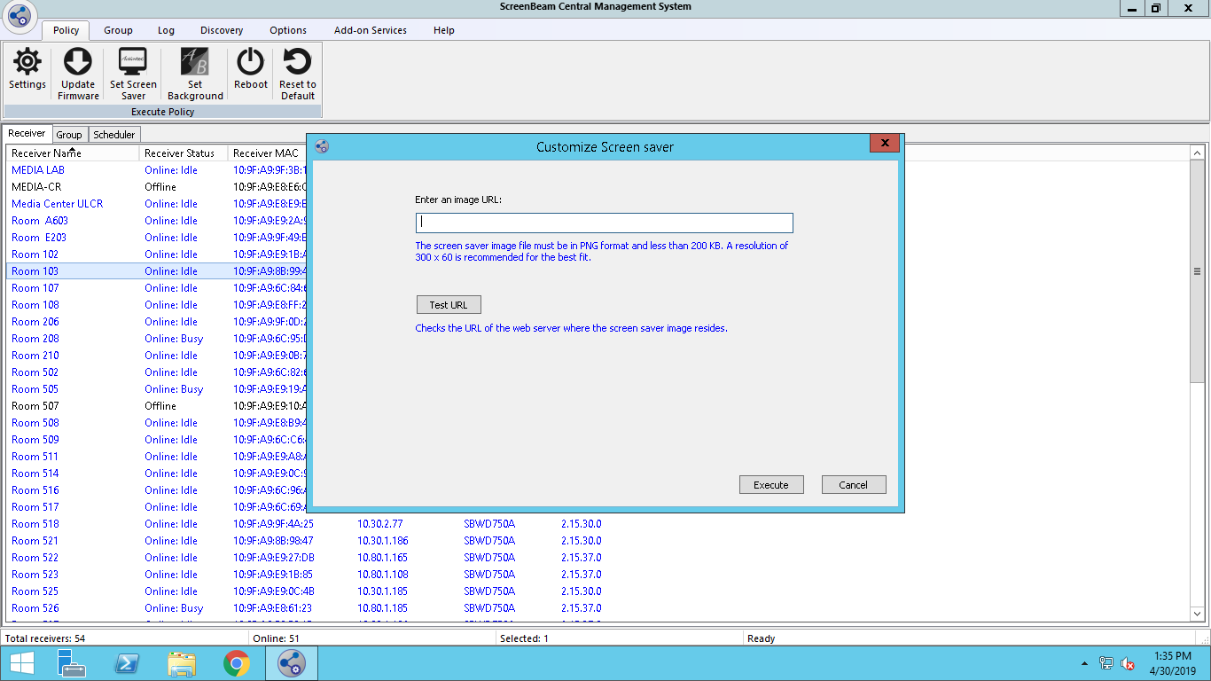

Slide 25
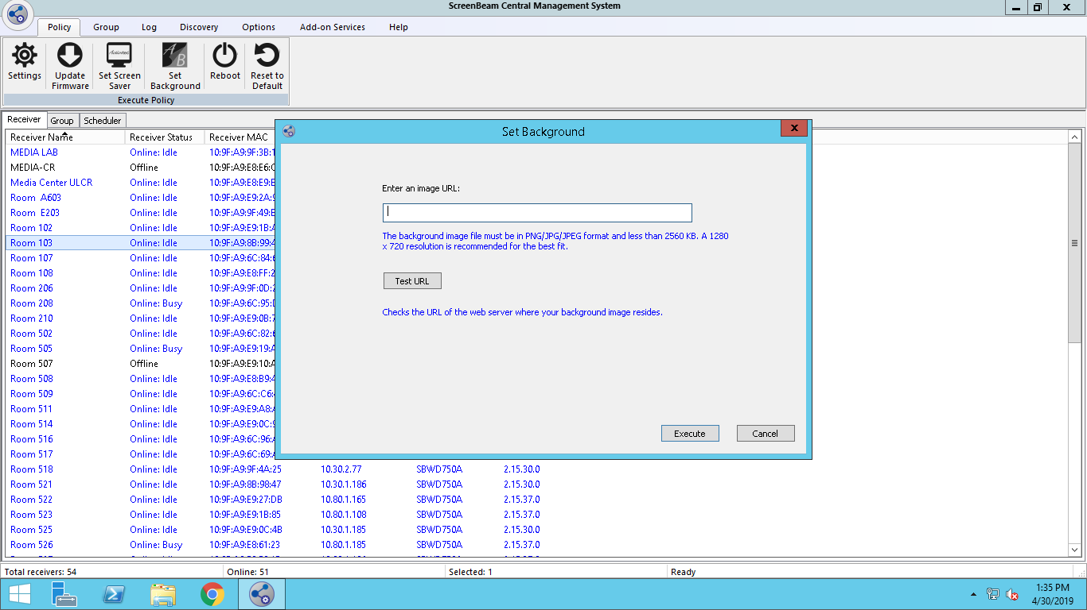

Slide 26
CMS – Group Settings

Slide 27
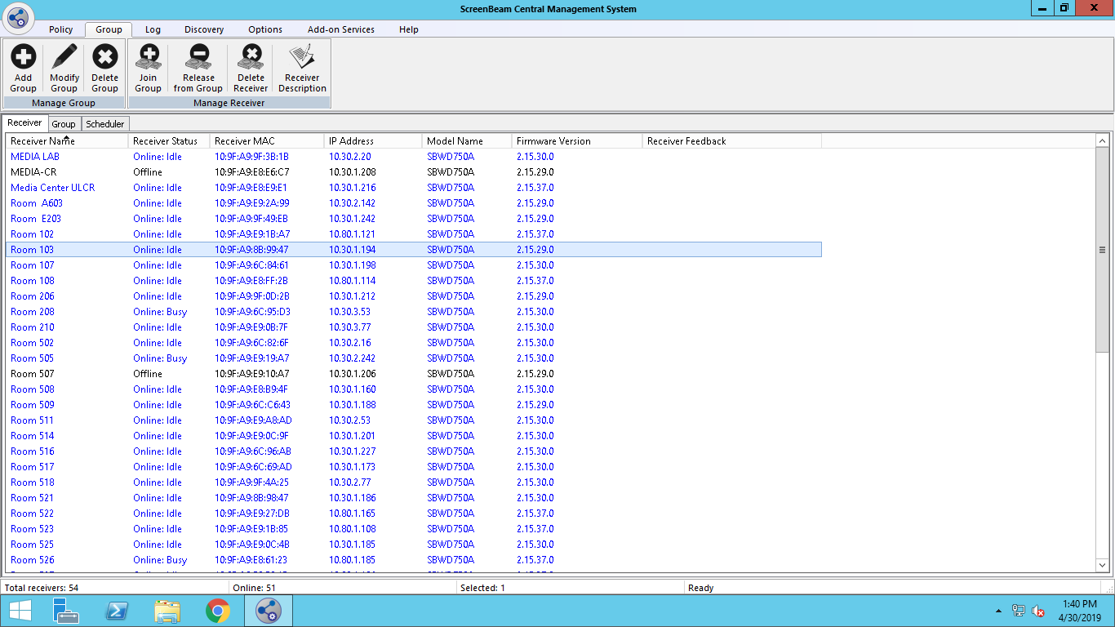

Slide 28
CMS – Log Settings

Slide 29
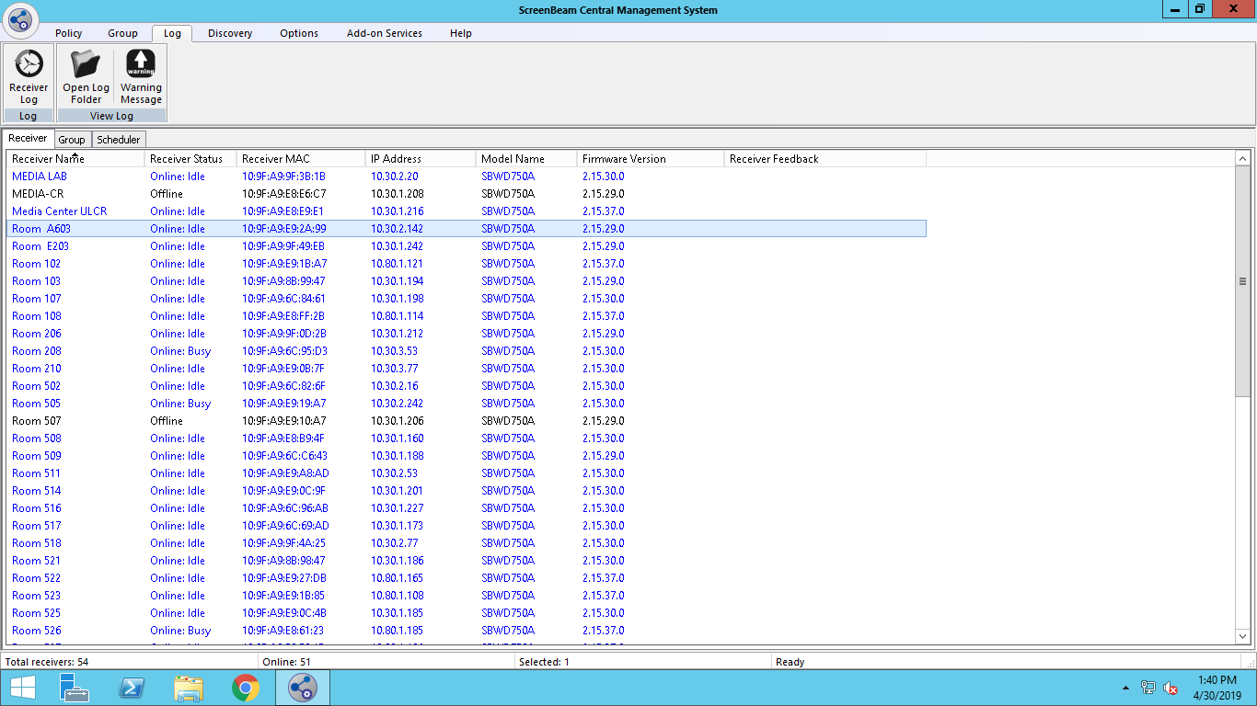

Slide 30
CMS – Discovery Settings

Slide 31
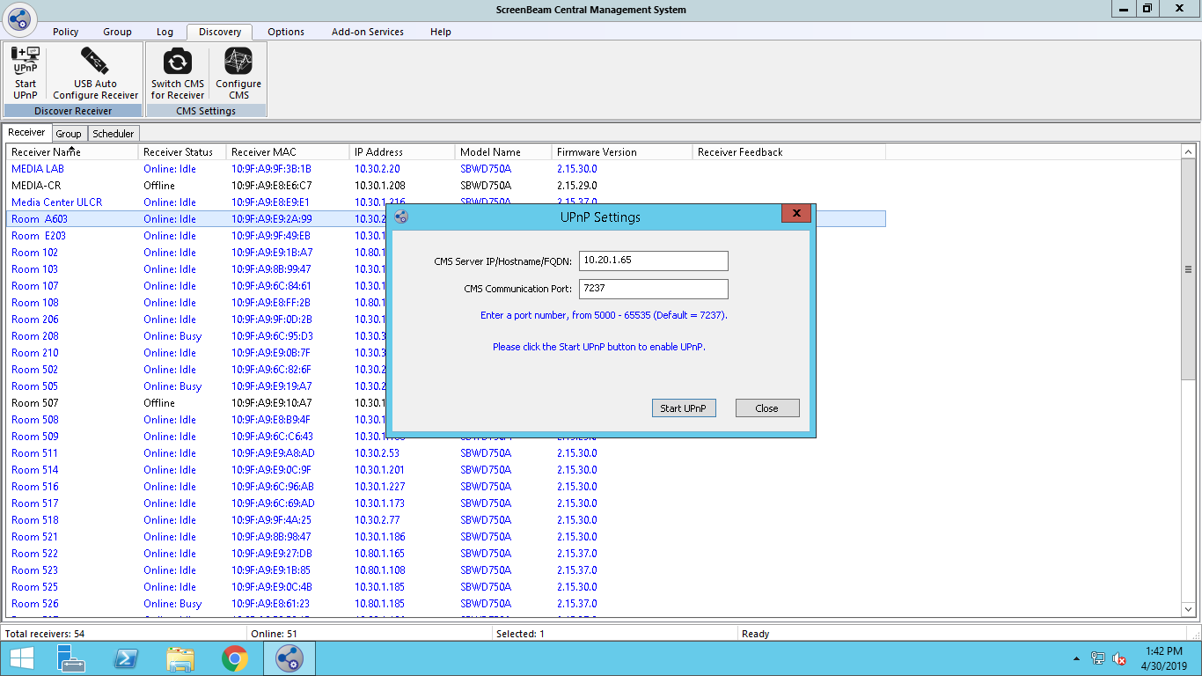

Slide 32
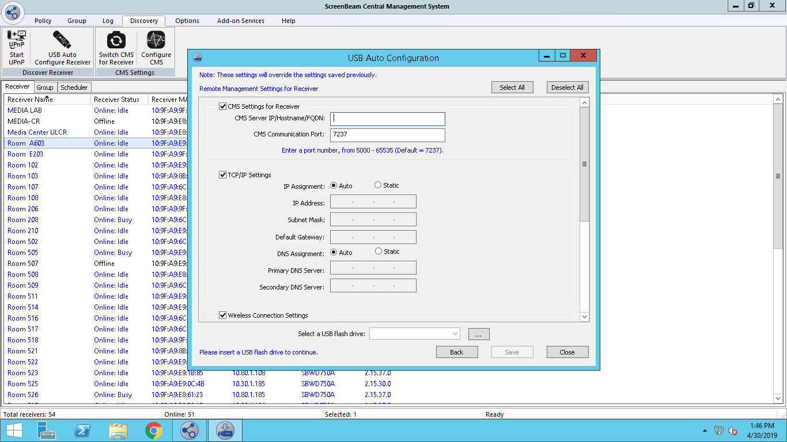

Slide 33
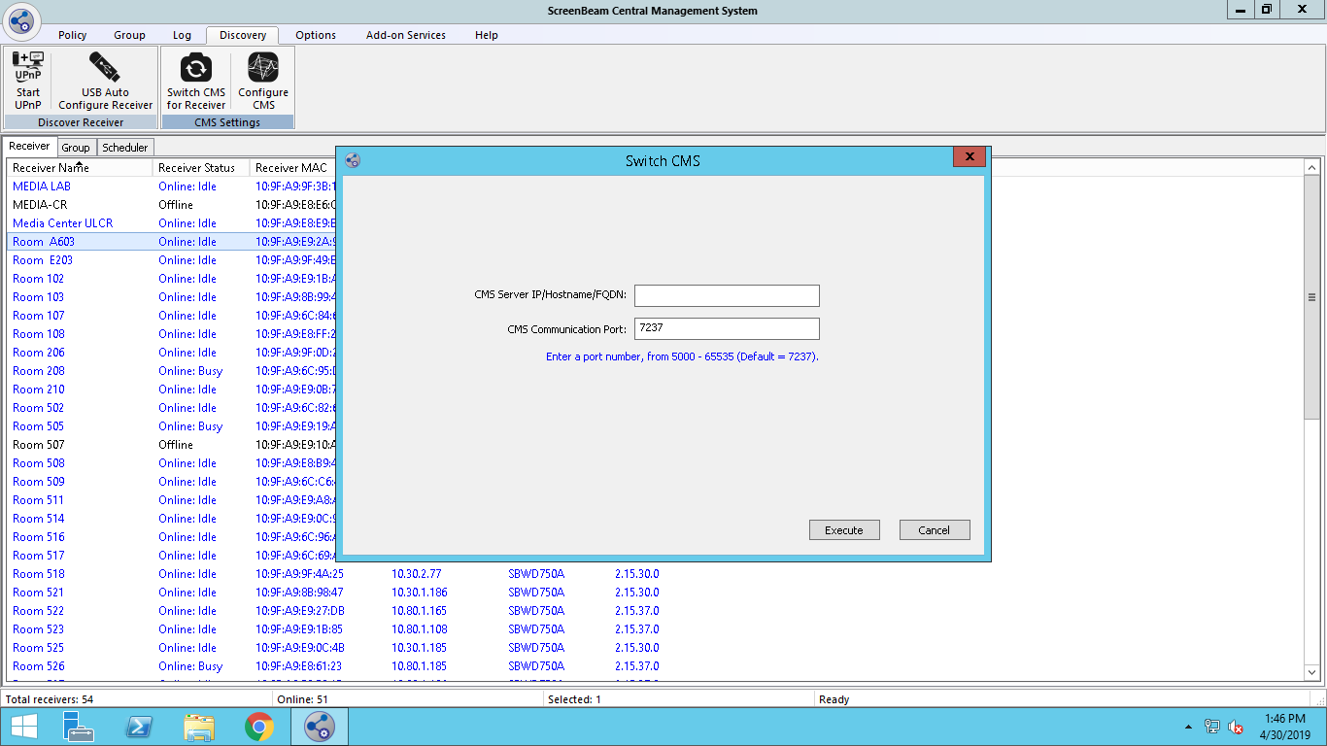

Slide 34
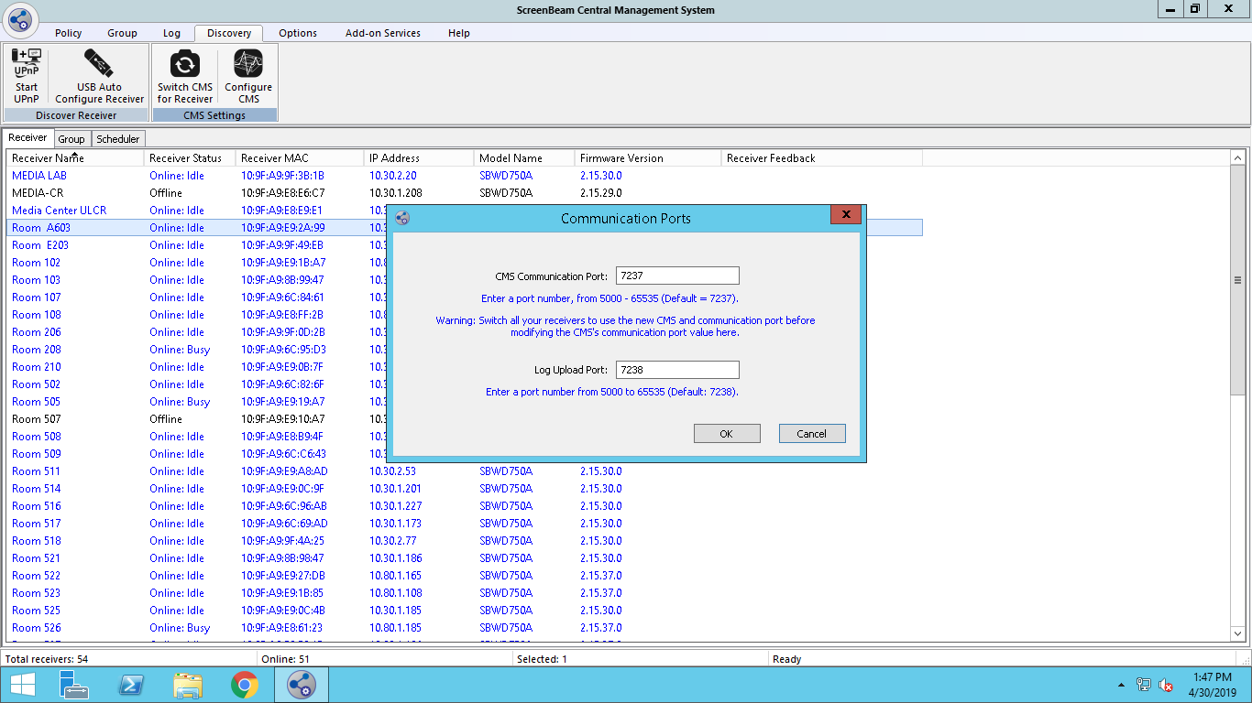

Slide 35
CMS – Option Settings

Slide 36
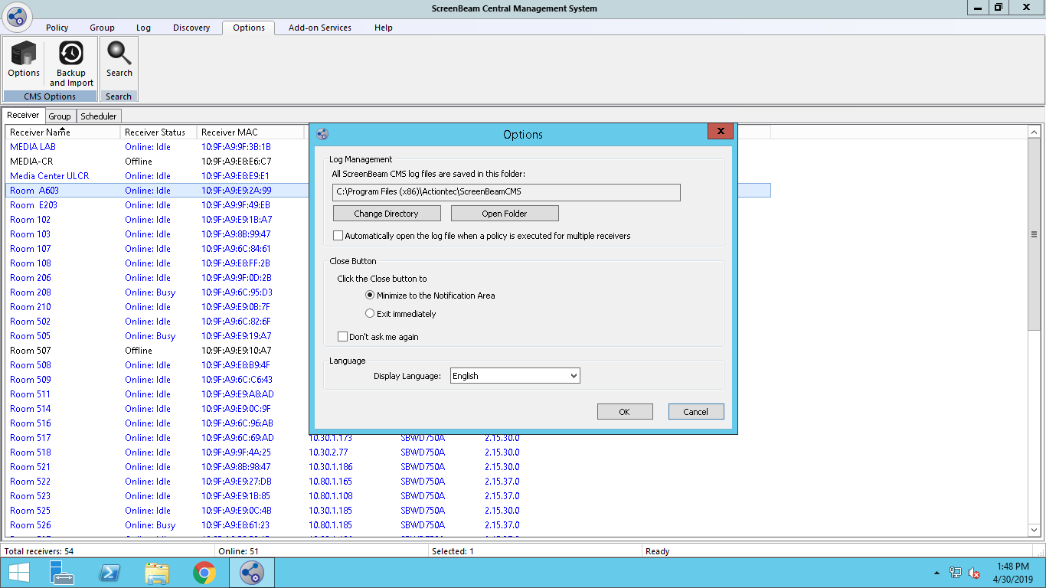

Slide 37
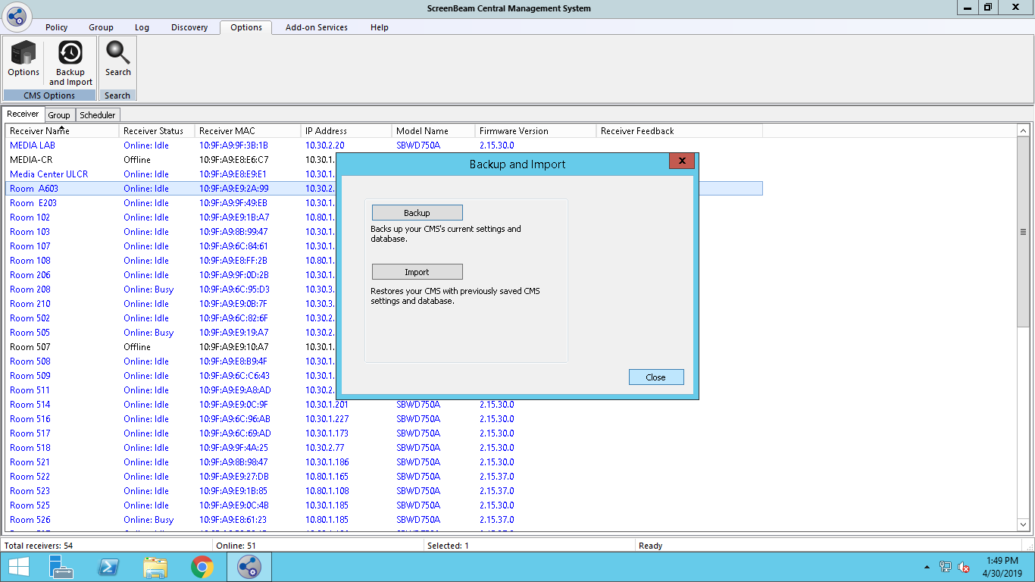

Slide 38
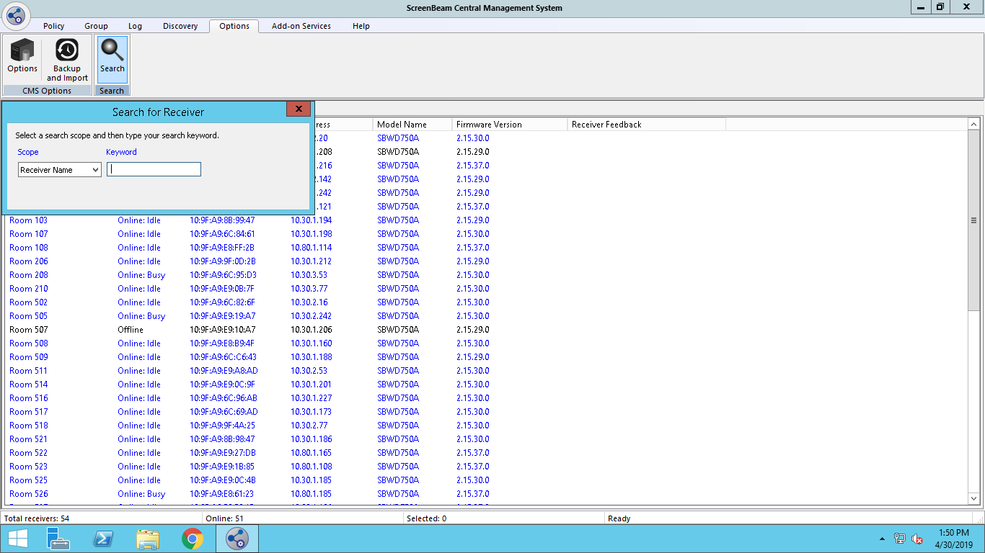

Slide 39
CMS – Add-On Services Settings

Slide 40
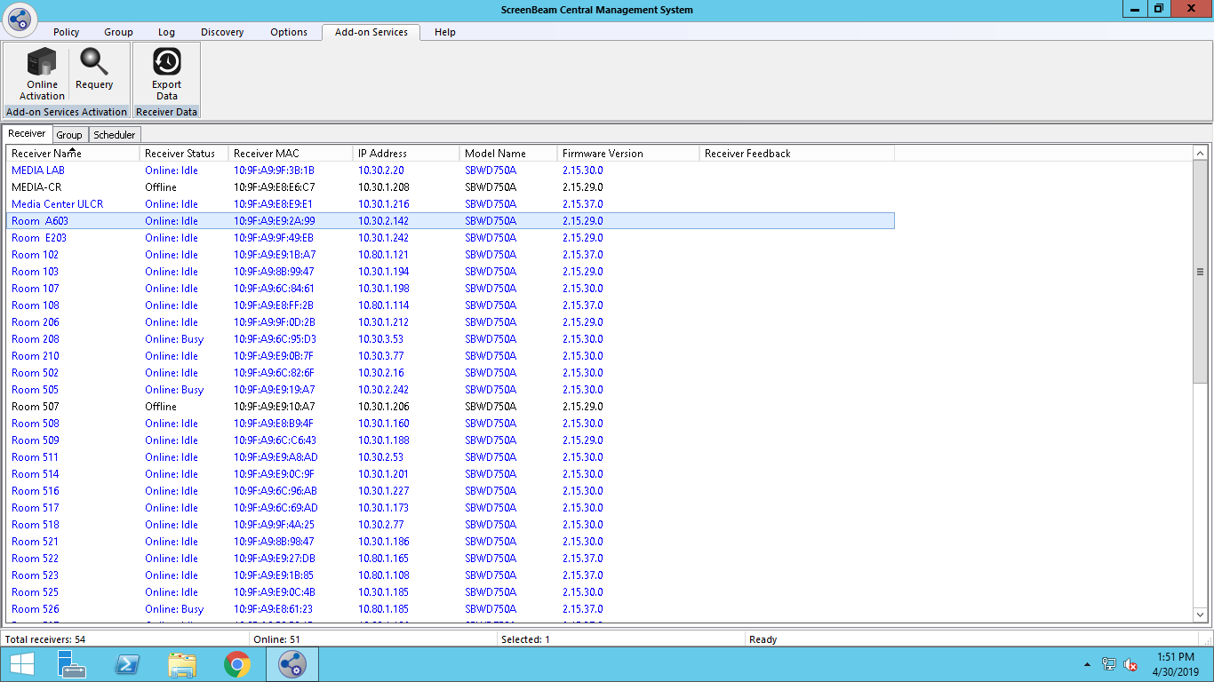

Slide 41
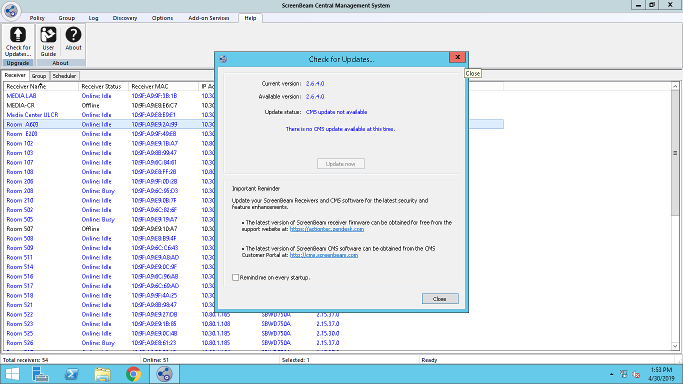

Slide 42
Managing without CMS

Slide 43
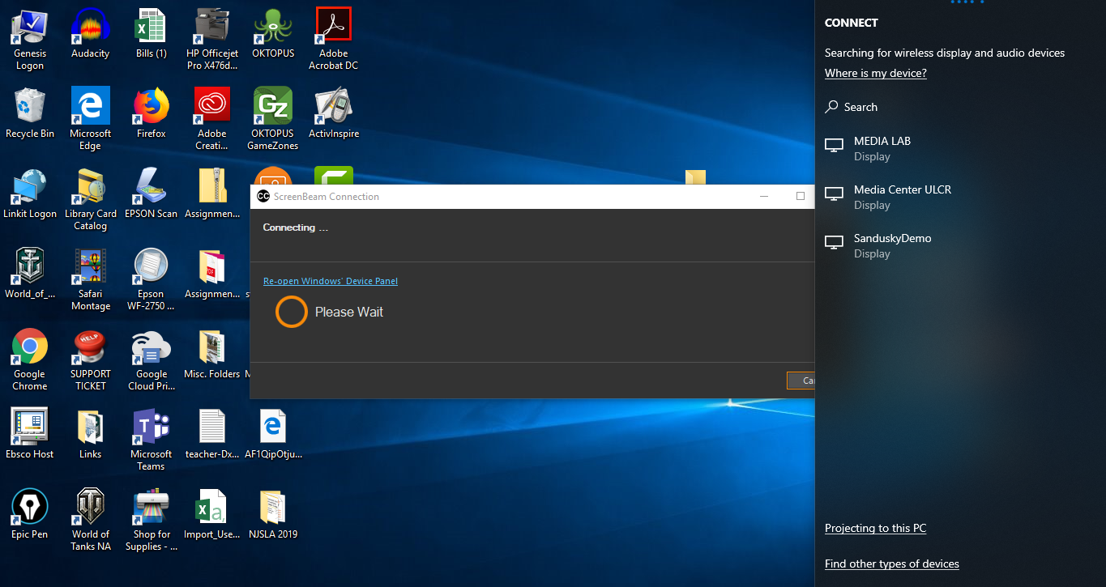
Configuration with out a CMS Server
Connect to the device
Once connected enter there following in a webrowser: 192.168.16.1
Username: Administartor
Password: Actiontec
Configuration GUI now open

Slide 44
My Contact information
Theodore Ragavas – Supervisor of Technology (Monmouth Regional High School)
Twitter: @NJTechHour
LinkedIn: https://www.linkedin.com/in/njtechhour/
Email: tragavas@monmouthregional.net
Presentation Link:
Request Demo Units (Please leave my name as referral): https://www.screenbeam.com/expert-program/referral-form/
Feedback of presentation:

Slide 45
ScreenBeam Info
ScreenBeam 960 Series - https://www.screenbeam.com/products/screenbeam-960/
Classroom Commander Info: https://www.screenbeam.com/products/screenbeam-classroom-commander/
Classroom Commander Guide (Firmware, tutorials & FAQ): https://screenbeam.zendesk.com/hc/en-us/categories/360001017892
Central Management Service Guide: https://screenbeam.zendesk.com/hc/en-us/categories/360001017912-Central-Management-System-CMS-
Classroom Commander Activation app: https://screenbeam.zendesk.com/hc/en-us/articles/360017691091-Classroom-Commander-License-Activation-Utility
Classroom Commander Teacher App (Windows): https://www.microsoft.com/en-us/p/classroom-commander-teacher/9nq7xxhfw0vd?activetab=pivot:overviewtab
Classroom Commander Student App (Windows): https://www.microsoft.com/en-us/p/classroom-commander-student/9n16cvzvw7zd?activetab=pivot:overviewtab
Download for PDQ or Group Policy: https://screenbeam.zendesk.com/hc/en-us/articles/360017419032-Classroom-Commander-App

Slide 46





Best Practices for District-wide Wireless Display Deployment -
MRHS Story
Theodore H. Ragavas
Microsoft K-12 Education Transformation Leader

Slide 47
Monmouth Regional High School – Tinton Falls, NJ
Grades 9 – 12
Regional High School ( 3 towns feeding into high school)
Approximately 1000 students
3 Technology Staff
Over 1200 devices Chrome / PC / Ipad

Slide 48
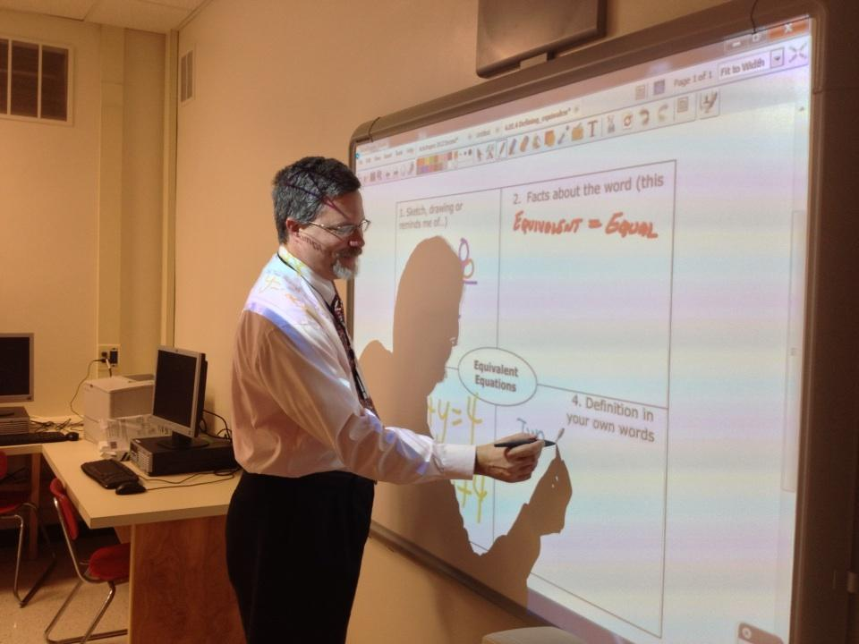
Problem: Teaching from the front of the room
Teaching from the front of the classroom
How do you change this style?
How do you incorporate new technology to support this change?
How do you become more accessible to student needs ?
How do you monitor student devices without buying classroom management software (LanDesk, Impero etc..)
https://education.fcps.org/trt/content/5-ways-use-activinspire-secondary-math

Slide 49
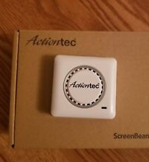
How we got started
Vendor give-a-way with no support
Self taught
Started with WiDi with Microsoft Windows 10

Slide 50
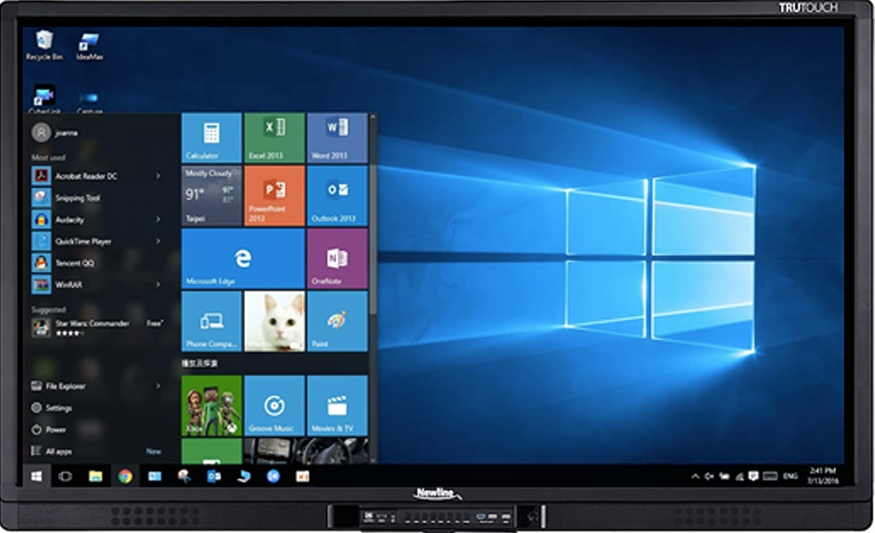
Where we are now!
Deployed over 50+ ScreenBeam ProBusiness Ed.
Deployed 1 ScreenBeam 960 with Classroom Commander
Setting up 2 more ScreenBeam 960 with Classroom Commander
Planning to add 10 more in the 2019-2020 school year
Most classrooms have the Newline UB Touch Interactive Display

Slide 51


Slide 52
Blog about whiteboard: https://edu-blog.screenbeam.com/2019/04/29/microsoft-whiteboard-wireless-display/?fbclid=IwAR0CnntxxE1REgBwVJ-MvWFsVuOG3wrUI5jkH0Xpub6lrGU0OeLaQ6mA7Xk

Slide 53
iOS and macOS devices with the ScreenBeam 960

Slide 54
iOS and macOS devices with the ScreenBeam 960
Upgrade the firmware on the ScreenBeam to 9.15.39.0 or newer
Configure the ScreenBeam to connect to your network, either by plugging in an Ethernet cable or connecting to your wireless network
Discovery with the native screen mirroring tools(Airplay) in iOS/macOS uses multicast DNS (mDNS), so mDNS will need to be enabled on your network, alternatively we provide apps for iOS and macOS which allow connection without mDNS, if you’re interested in non-mDNS options I can provide more info
Once your ScreenBeam is on the 9.15.39.0 or newer firmware and connected to your network you should be able to use the Screen Sharing tool built in to iOS and macOS to wirelessly share your display.

Slide 55
Need to know Settings
Teacher/Student App

Slide 56
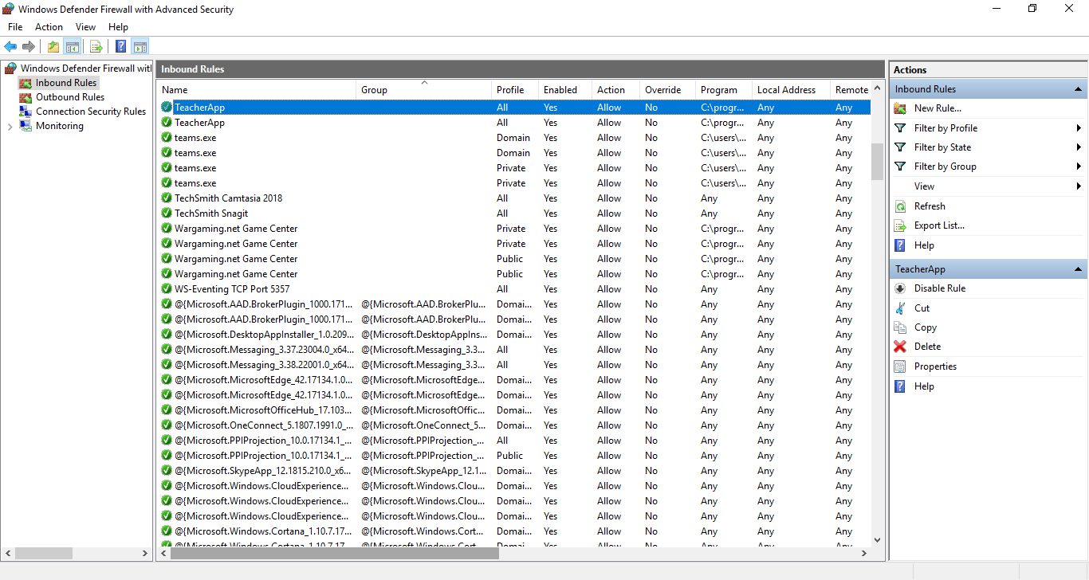
*** Windows Firewall Inbound Rule Teacher ***

Slide 57
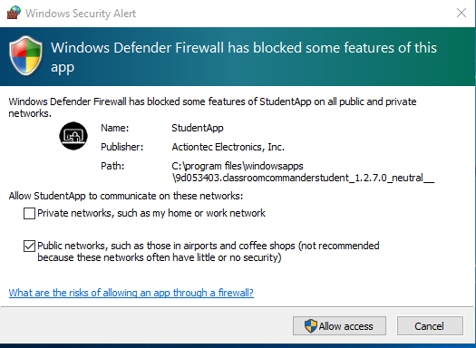
Firewall Allowance - Student

Slide 58
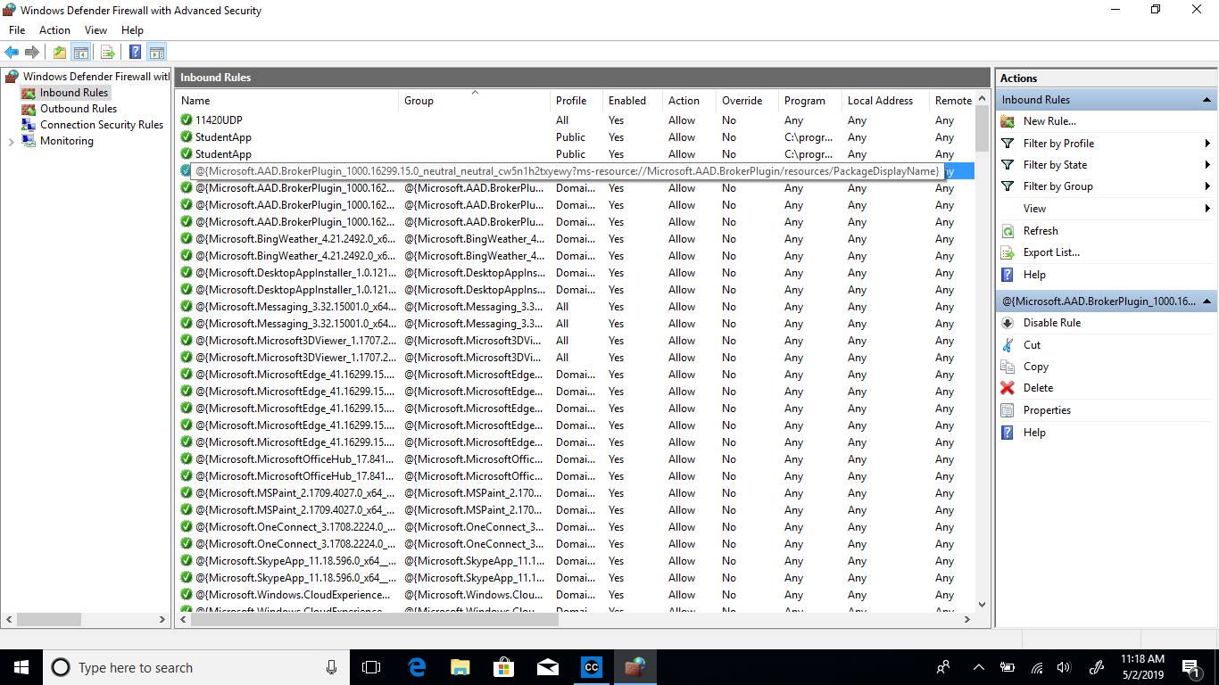
*** Windows Firewall Inbound Rule Teacher ***

Slide 59

Classroom Commander Teacher App

Slide 60
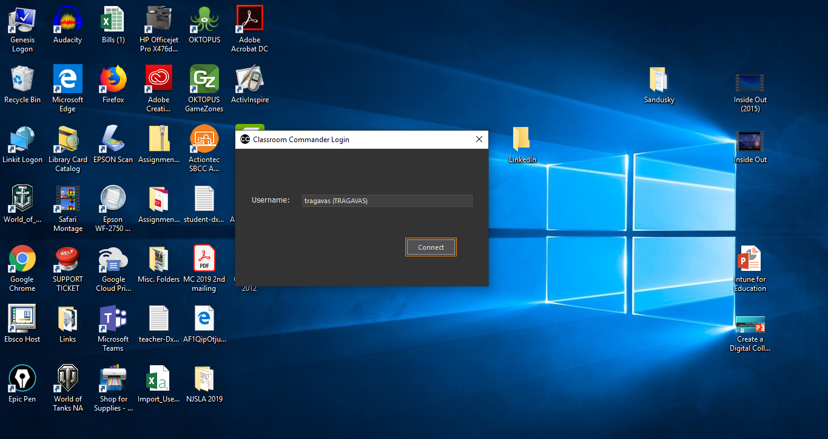

Slide 62
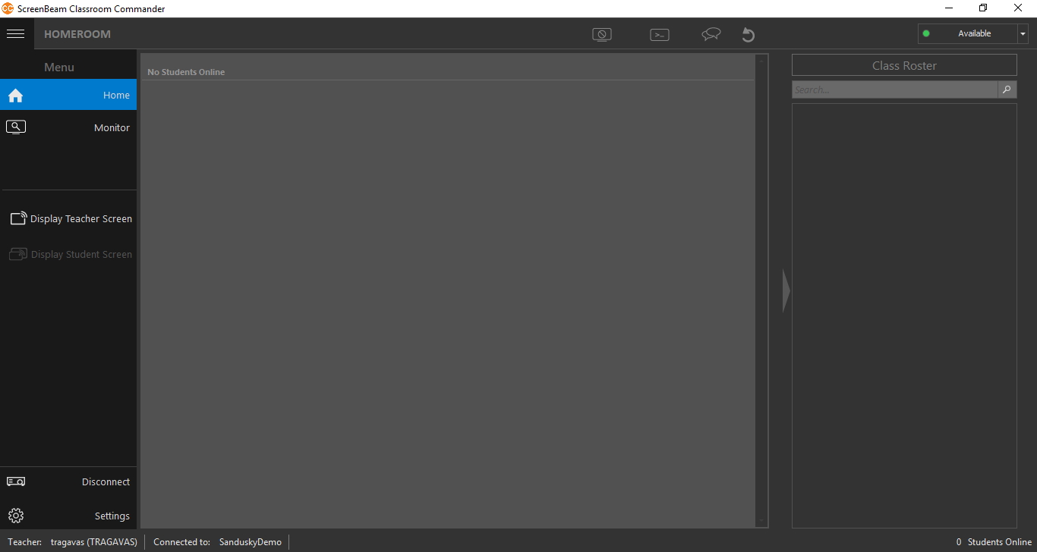

Slide 63
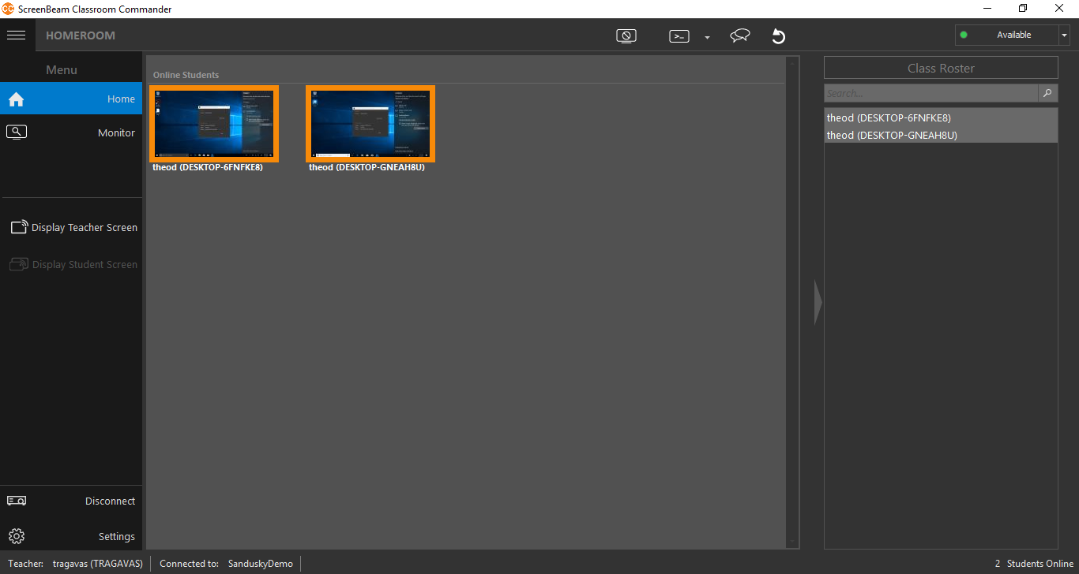

Slide 64
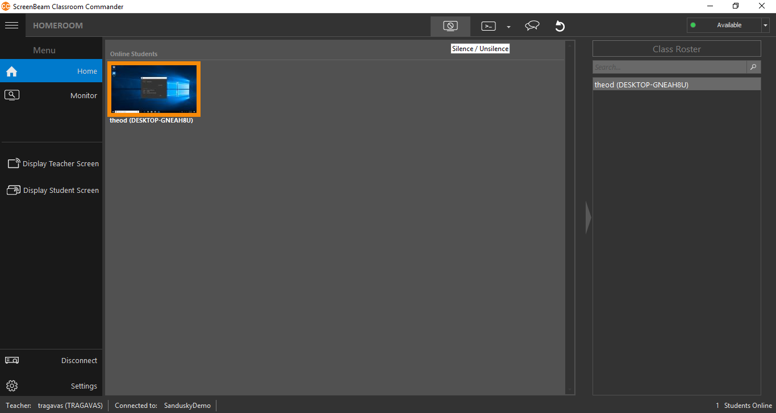

Slide 65
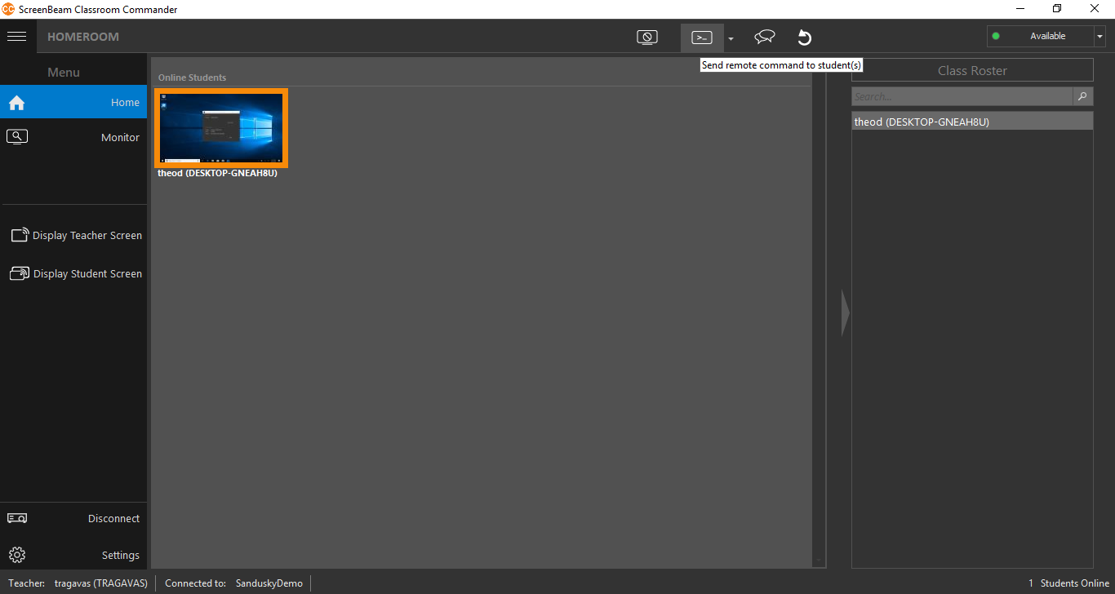

Slide 66
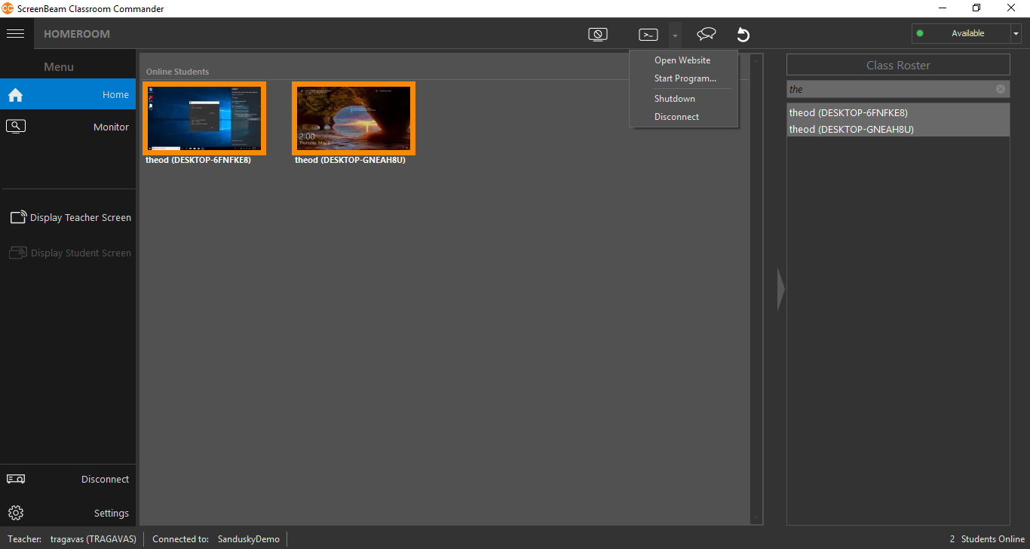

Slide 67
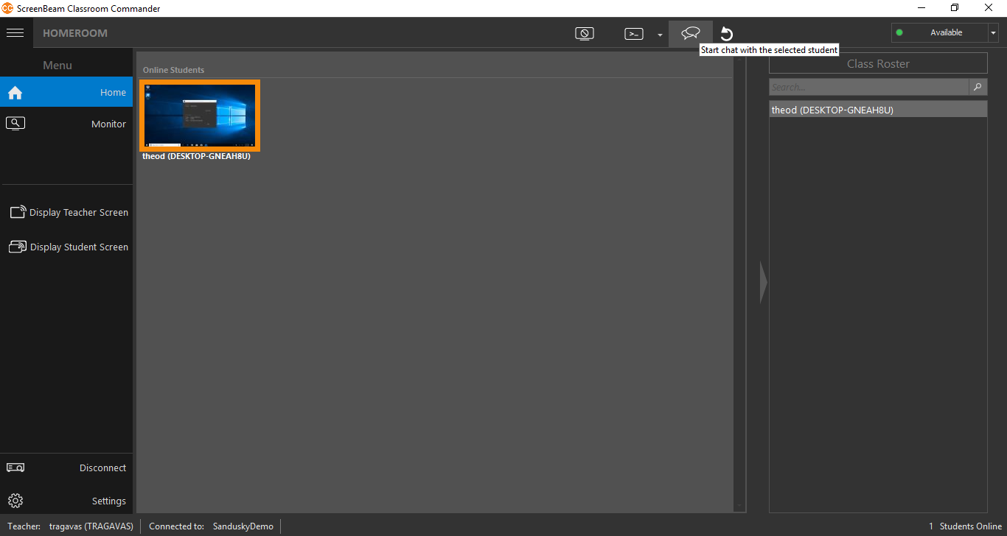

Slide 68
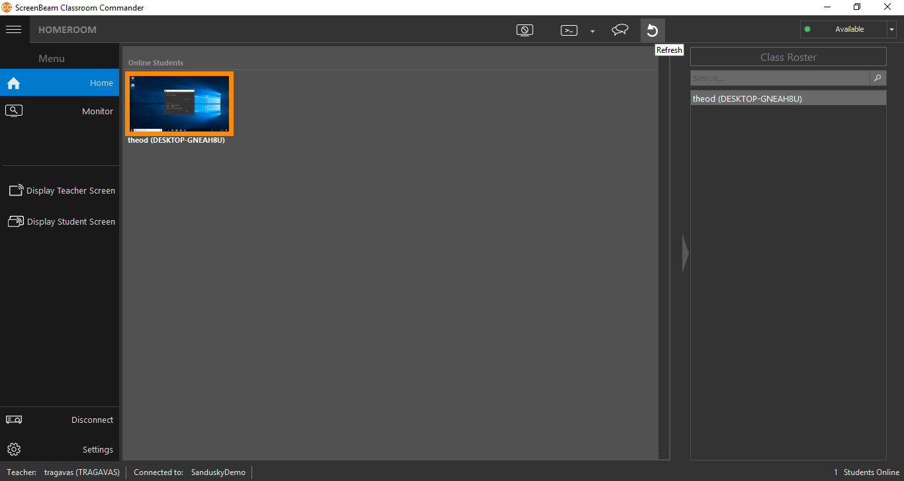

Slide 69


Slide 70


Slide 71

Classroom Commander Student App

Slide 72
Major Key for this to work

Slide 73

This will use the Windows username that was logged in.
If you use student ID#’s or something other then name the teacher will have know those logins

Slide 74


Slide 75


Slide 76

Students can chat with the teacher only,
There is no student to student communication

Slide 77
Connecting to a ScreenBeam without Classroom Commander
(Windows Version)

Slide 78
Actiontec Wireless Display Demo

Slide 79






Different presentation options

